Slide 1
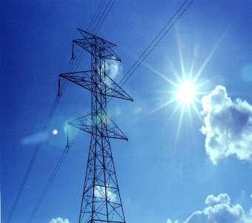
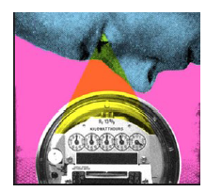


Cyber-Security and Privacy Challenges in the Electrical Power System
Lalitha Sankar
School of Electrical, Computer, and Energy Engineering
Arizona State University

Slide 2
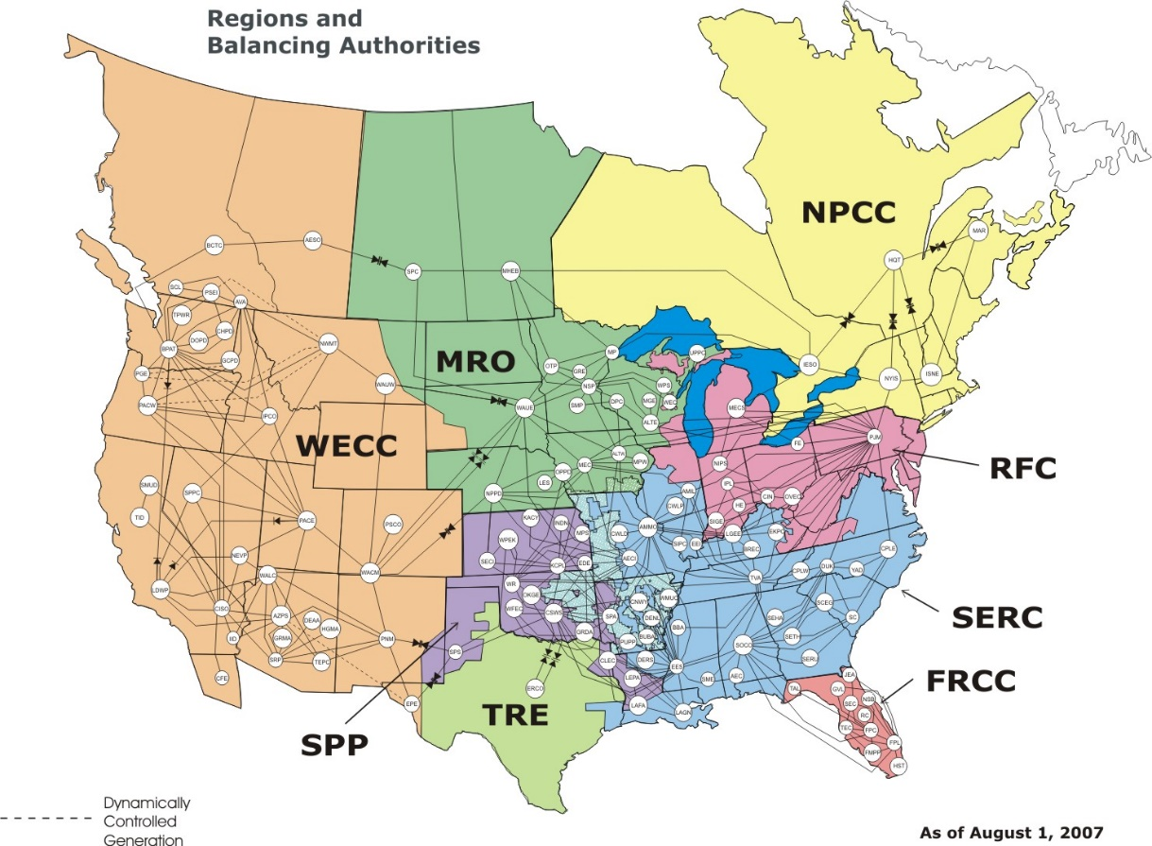
North American Electric Power Grid
US is 18% of world consumption as of 2015.
3200 electric utility companies
17,000 power plants
800 GW peak demand
165,000 miles of high-voltage lines
140 million meters
$ 1 trillion in assets
D. Wollman, “Accelerating Standards and Measurements for the Smart Grid,” National Institute of Standards and Technology (NIST), U.S. Department of Commerce.
[Online] https://www.superlectures.com/icassp2011/downloadFile.php?id=322&type=slides&filename=accelerating-standards-and-measurements-for-the-smart-grid

Slide 3
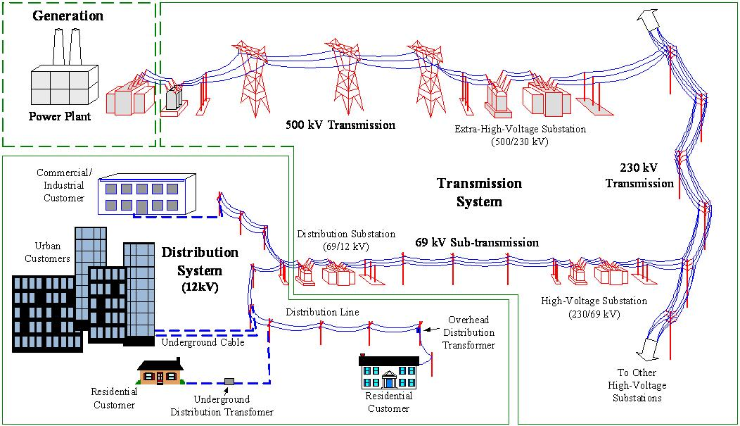
Electric Power System
Generation, transmission, and distribution model
Transmission System

Slide 4
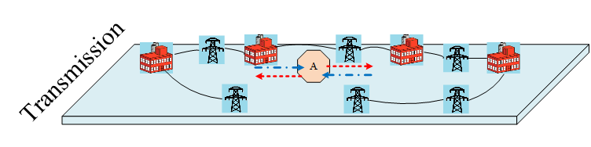
Hierarchical Cyber-physical Power System
Hierarchical Cyber-physical Power System

Slide 5
Energy Management System (EMS)
Estimate system complex voltages
Determine important lines and generators to monitor
Determine next instant generation dispatch action

Slide 6
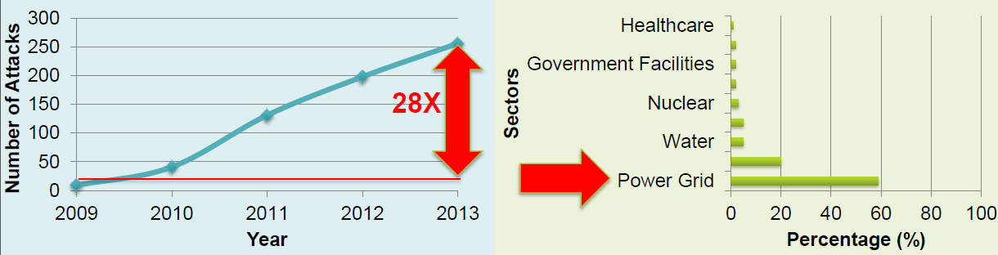
Motivation
Electric power system is vulnerable to cyber attacks
  Stuxnet malware attacks SCADA systems in Germany in 2010
  Ukraine power grid attacks in 2015
DHS recorded 161 cyber attacks on the energy sector in 2013, compared to 31 in 2011

Slide 7
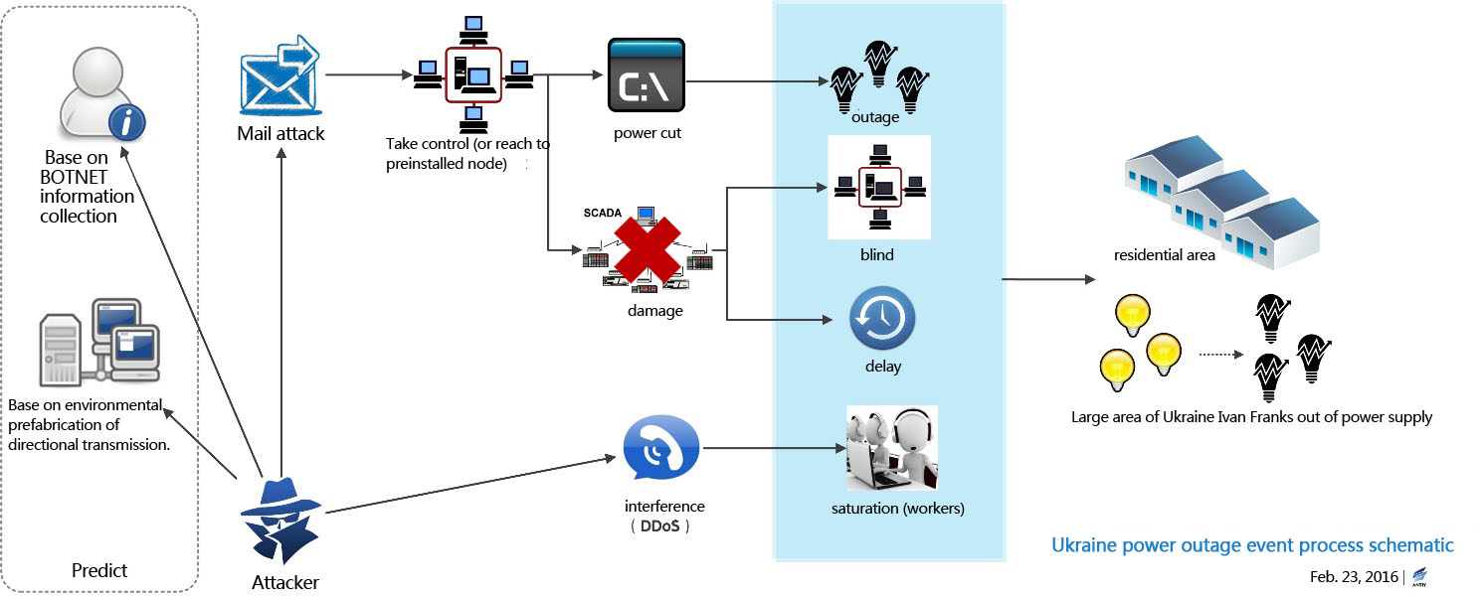
Ukraine Cyber Attack
Cyber attack against Ukraine power grid illuminated the urgency of prognosis of cyber attacks on open-source EMS platform
Can cascading outages and failures be achieved by intelligent attacks on the cyber-infrastructure of electric power systems?
Antiy Labs, “Comprehensive analysis report on Ukraine power system attacks,” March 2016. [Online]. Available: http://www.antiy.net/p/comprehensive-analysis-report-on-ukraine-power-system-attacks/

Slide 8
Two-Pronged Approach
Theoretical Work
Simulation Platform
Analyze potential attacks
Characterize system vulnerabilities
Develop countermeasure algorithms
Java-based, high-fidelity EMS (Energy Management System) simulation
Simulate attacks and system response on large scale systems
IMPLEMENT
VERIFY

Slide 9
False Data Injection (FDI) Attack
Knowing system configuration, attacker can inject malicious data (measurements) without detection by existing techniques for bad data detection
Requires attacker to have access to remote terminal units (RTUs) or local data concentrators
Replace actual data packets with carefully constructed malicious data packets and impersonate a valid data source

Slide 10

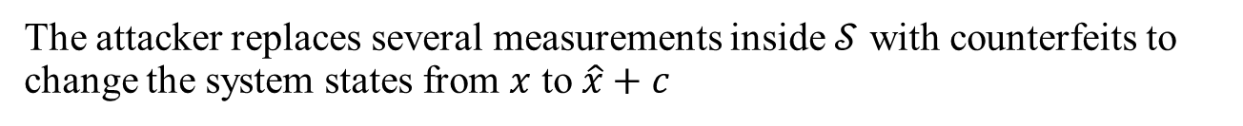
System and Attack Model
The attacker replaces several measurements inside $𝒮$ with counterfeits to change the system states from $x$ to $\hat{x}+c$

Slide 11
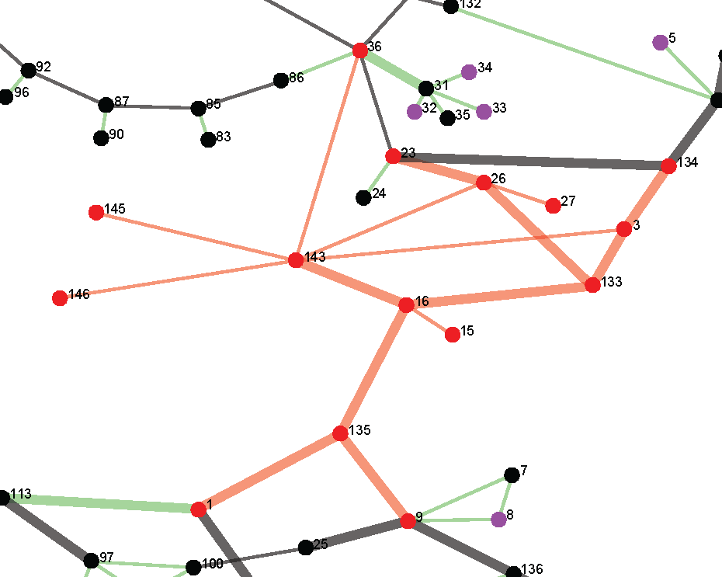
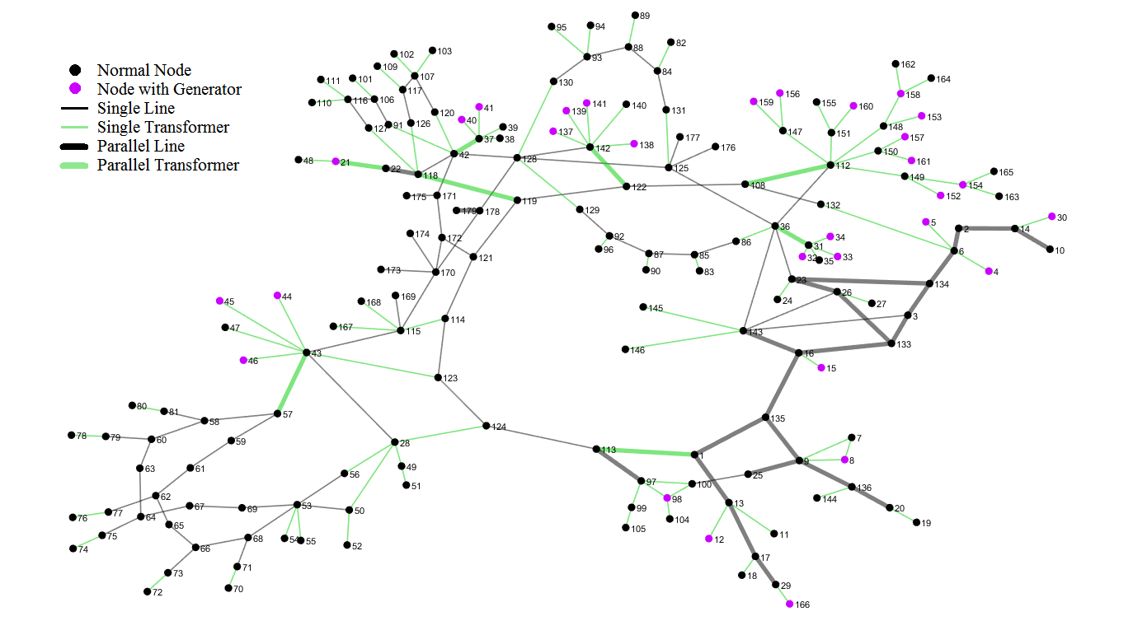
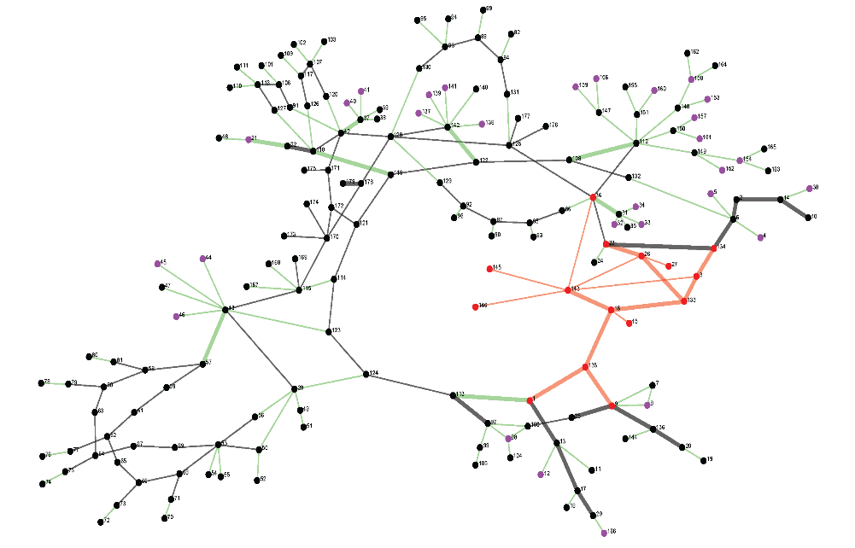
Worst-case Line Overflow FDI Attacks
Attack Design:
Find attack vector to overflow congested line 16 - 133
Determine attack subgraph
Collect measurements inside the subgraph
Perform local state estimation and inject attack vector
Node
3 | -0.0939 | -0.0930
15 | 0.0221 | 0.0211
16 | -0.0309 | -0.0318
26 | -0.0585 | -0.0580
27 | -0.0676 | -0.0652
133 | -0.0506 | -0.0508
135 | -0.0143 | -0.0150
143 | -0.0455 | -0.0470
145 | -0.0485 | -0.0506
146 | -0.0485 | -0.0506
- Local estimated states
- Local estimated states with attack
J. Liang, L. Sankar, and O. Kosut, “Vulnerability analysis and consequences of false data injection attack on power system state estimation,” IEEE Transactions on Power Systems, vol. PP, no. 99, pp. 1–9, 2016

Slide 12
Worst-case Line Overflow FDI Attacks
Attack Design:
Line | (MW) | (MW)
135 – 1 | -361.41 | -365.96
3 – 133 | -312.65 | -304.98
134 – 3 | 264.05 | 259.85
3 – 143 | -346.65 | -329.89
9 – 135 | -126.72 | -122.63
16 – 15 | -536.97 | -535.92
133 – 16 | -359.15 | -346.74
16 – 135 | -199.93 | -203.06
143 – 16 | -270.76 | -281.56
23 – 26 | 64.40 | 59.29
26 – 27 | 89.79 | 72.00
26 – 133 | -45.05 | -40.38
26 – 143 | -74.23 | -61.87
36 – 143 | 150.43 | 151.78
143 – 145 | 4.89 | 5.87
143 – 146 | 4.89 | 5.87
Calculate and inject false measurements
- Actual from side line flow measurements
- False from side line flow measurements

Slide 13
Worst-case Line Overflow FDI Attacks
System SE with false measurements:
Node
3 | -0.0938 | -0.0930
15 | 0.0221 | 0.0211
16 | -0.0309 | -0.0318
26 | -0.0585 | -0.0580
27 | -0.0676 | -0.0652
133 | -0.0506 | -0.0508
135 | -0.0143 | -0.0150
143 | -0.0455 | -0.0470
145 | -0.0486 | -0.0506
146 | -0.0485 | -0.0506
  Residue: 837.88 < Threshold
  No bad data detected!
  This attack is unobservable to SE!
- Estimated states without attack
- Estimated states with attack

Slide 14
Worst-case Line Overflow FDI Attacks
Load information updated after SE
Node | Actual Load (MW) | False Load (MW) | % Change
1 | 94 | 76 | -19.7%
3 | 1759 | 1715 | -2.5%
9 | 309 | 297 | -4.1%
15 | 5 | 6 | 20.0%
16 | 74 | 89 | 19.9%
23 | 79 | 94 | 19.8%
26 | 268 | 248 | -7.2%
27 | 90 | 72 | -19.8%
36 | 38 | 37 | -3.6%
134 | 64 | 77 | 19.6%
135 | 264 | 282 | 6.9%
143 | 257 | 307 | 19.6%
145 | 4.9 | 5.9 | 19.8%
146 | 4.9 | 5.9 | 19.8%
Load change due to attack

Slide 15

Worst-case Line Overflow FDI Attacks
System re-dispatch with AC OPF
  Several generators re-dispatch due to the false load
~
~
~
~
~

Slide 16
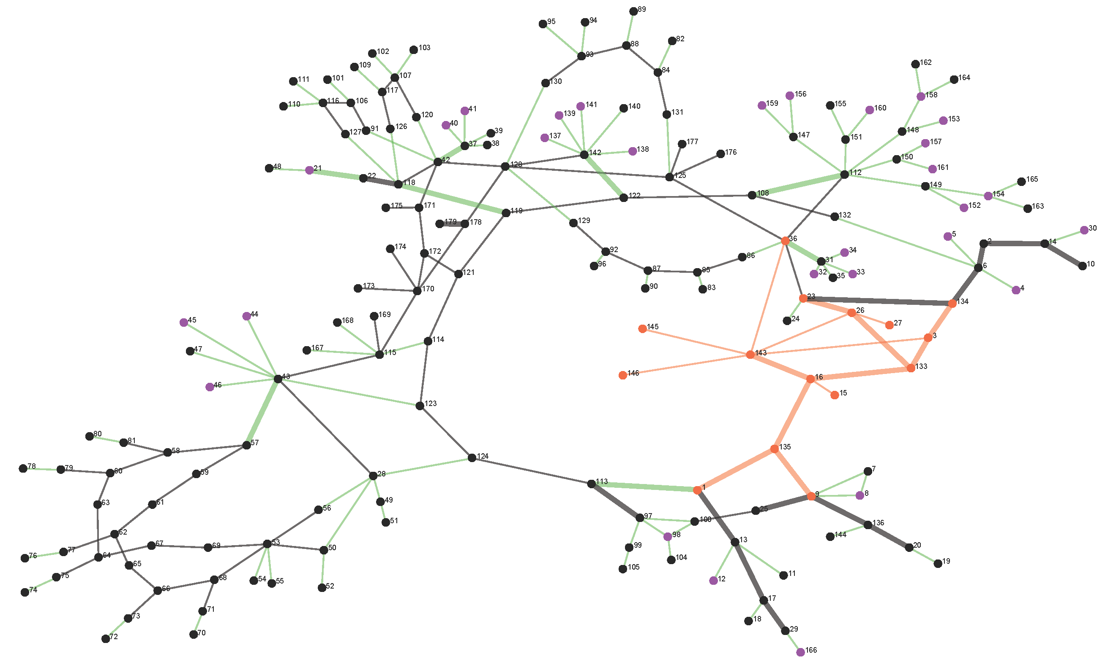
Worst-case Line Overflow FDI Attacks
~
~
~
~
~
In the next operation interval, attacker sustains the attack
SE results:
  Residue: 735.29 < Threshold
  No bad data detected!
Power flow comparison:
Line overflow caused by FDI attack cannot be detected!!
Line | Physical Power Flow | Cyber Power Flow
171 & 172 | 103.62% | 100%

Slide 17
Optimization for worst-case attacks
Notes:
We introduce a bi-level attack optimization problem to determine the worst-case FDI attacks that can maximize the power flow on a target line. In the first level, the attack vector is chosen subject to the limited attack resources and load shifts (point the corresponding equation).
In the second level, the system response to the attack determined in the first level is modeled via DC OPF (objective to minimize the total cost, subject to power balance constraints, thermal limit constraints, and generation limit constraints).

Slide 18
Numerical Results
Test on IEEE 24-bus RTS system
Line flow (%)
l₁-norm constraint (rad)

Slide 19
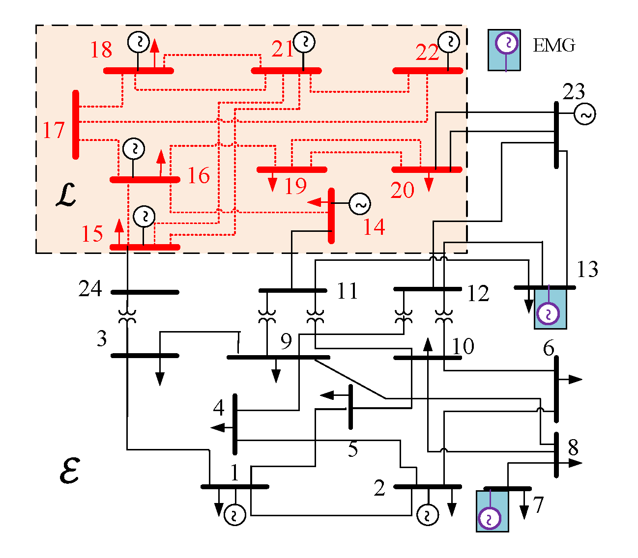
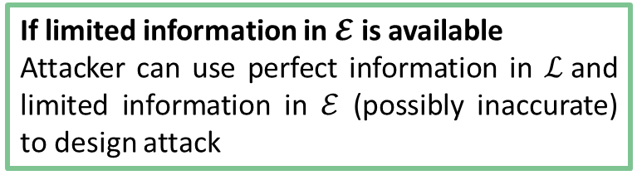
Attack Feasibility – Limited Attacker Information
Typically, the attacker is assumed to have complete knowledge of the system
What if the attacker’s information is limited to a sub-network?
We introduce a class of limited information FDI attacks and show that
?
If limited information in $𝓔$ is available
Attacker can use perfect information in $ℒ$and limited information in $ℰ$ (possibly inaccurate) to design attack
If no information in $𝓔$ is available
Attacker can use machine learning to learn $ℰ$ via historical data and then design attack
J. Zhang, Z. Chu, L. Sankar and O. Kosut, "False data injection attacks on power system state estimation with limited information," 2016 IEEE Power and Energy Society General Meeting (PESGM), Boston, MA, USA, 2016, pp. 1-5.
J. Zhang, Z. Chu, L. Sankar, and O. Kosut, “Can attackers with limited information exploit historical data to mount successful false data injection attacks on power systems?” IEEE Transactions on Power Systems, 2017, submitted. [Online]. Available: https: //arxiv.org/pdf/1703.07500.pdf

Slide 20
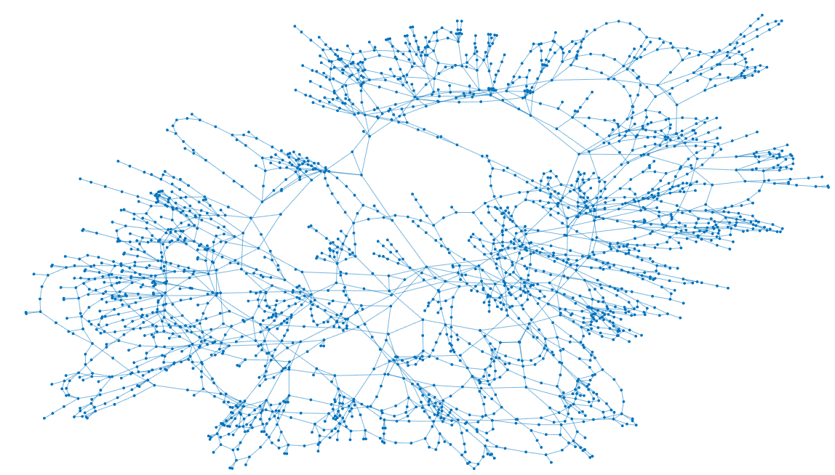
Attack Feasibility – Feasible for Large-scale Network?
FDI attack model: bi-level optimization problem that is then converted to single-level mixed integer linear programming (MILP)
Problem is intractable for large power systems
Can we evaluate the vulnerability of large-scale system to FDI attacks?
We have shown that
Approximation approaches that EMSs already used can be utilized in both attack design and system vulnerability analysis
Still vulnerable?
Z. Chu, J. Zhang, O. Kosut, and L. Sankar, "Evaluating Power System Vulnerability to False Data Injection Attacks via Scalable Optimization," 2016 IEEE International Conference on Smart Grid Communications (SmartGridComm), Sydney, 2016, pp. 1-6.

Slide 21
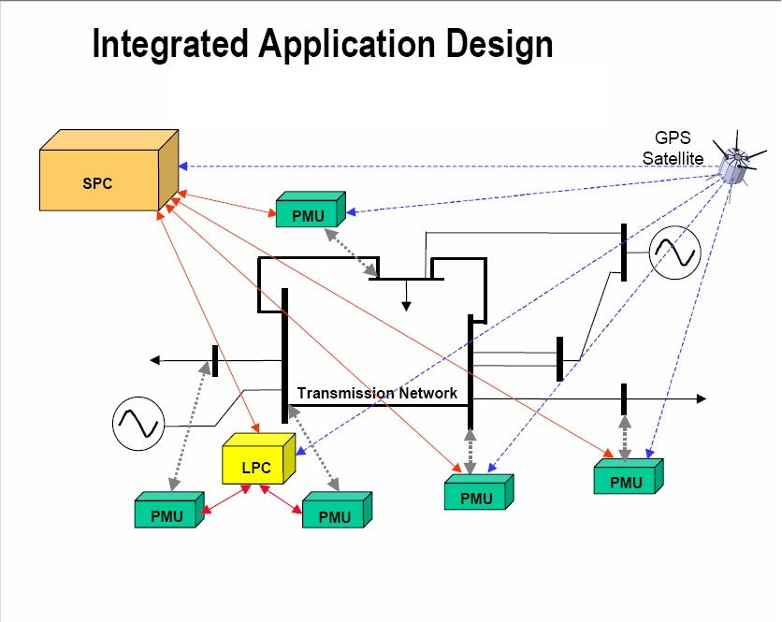
Attack Feasibility – Are PMU Vulnerable to FDI Attacks?
Phasor Measurement Units (PMUs) provide fine grid information
  Are PMU data vulnerable to cyber attacks?
  Can PMUs be utilized to increase resiliency?
We have shown that
?
Attacker that can mimic PMU time-series behavior can mount successful FDI attacks to corrupt PMU data
?
J. Zhang, Z. Chu, L. Sankar, and O. Kosut, " False Data Injection Attacks on Phasor Measurements That Bypass Low-rank Decomposition," 2017 IEEE International Conference on Smart Grid Communications (SmartGridComm), submitted, 2017, pp. 1-6.

Slide 22
On-going Work
Vulnerability identification can be used to design countermeasures
Cyber Attack Decision Support Tool

Slide 23
Publications
J. Liang, O. Kosut, and L. Sankar, “Cyber-attacks on ac state estimation: Unobservability and physical consequences,” in IEEE PES General Meeting, Washington, DC, July 2014.
J. Zhang and L. Sankar, “Implementation of unobservable state-preserving topology attacks,” in North American Power Symposium (NAPS), 2015, pp. 1-6, Oct 2015.
J. Liang, L. Sankar, and O. Kosut, “Vulnerability analysis and consequences of false data injection attack on power system state estimation,” IEEE Transactions on Power Systems, vol. 31, no. 5, pp. 3864–3872, Sept 2016.
J. Zhang and L. Sankar, "Physical System Consequences of Unobservable State-and-Topology Cyber-Physical Attacks," in IEEE Transactions on Smart Grid, vol. 7, no. 4, pp. 2016-2025, July 2016.
J. Zhang, Z. Chu, L. Sankar and O. Kosut, "False data injection attacks on power system state estimation with limited information," 2016 IEEE Power and Energy Society General Meeting (PESGM), Boston, MA, USA, 2016, pp. 1-5.
Z. Chu, J. Zhang, O. Kosut, and L. Sankar, "Evaluating Power System Vulnerability to False Data Injection Attacks via Scalable Optimization," 2016 IEEE International Conference on Smart Grid Communications (SmartGridComm), Sydney, 2016, pp. 1-6.
J. Zhang, Z. Chu, L. Sankar, and O. Kosut, “Can attackers with limited information exploit historical data to mount successful false data injection attacks on power systems?” IEEE Transactions on Power Systems, 2017, submitted. [Online]. Available: https: //arxiv.org/pdf/1703.07500.pdf
J. Zhang, Z. Chu, L. Sankar, and O. Kosut, " False Data Injection Attacks on Phasor Measurements That Bypass Low-rank Decomposition," 2017 IEEE International Conference on Smart Grid Communications (SmartGridComm), submitted, 2017, pp. 1-6.

Slide 24
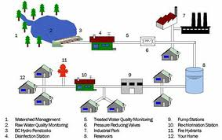

Other Critical Infrastructure
Security for water management and distribution systems
SCADA based systems -- vulnerable to FDI attacks
Limited information sharing across monitoring agents – a vulnerability

Slide 25
Privacy Challenges in the Smart Grid

Slide 26
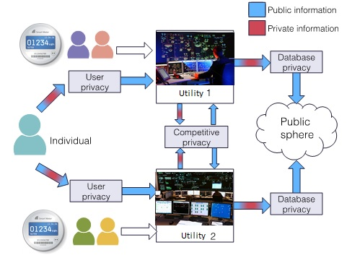
Privacy in Smart Grid
Privacy occurs at various data collecting/monitoring interfaces in the grid
Advanced Metering Infrastructure (AMI): can infer user behavior
Competitive privacy: tradeoff between data sharing and privacy/security

Slide 27

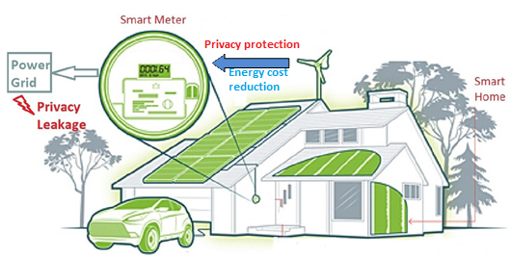
AMI: Privacy and Incentives
Electricity Provider (EP) can monitor fine grained energy consumption behavior through smart meters
Consumers (CS) can protect their privacy via adopting privacy preserving algorithms to mask consumption profile
Access to alternative energy sources enables energy cost reduction and privacy protection for each CS

Slide 28
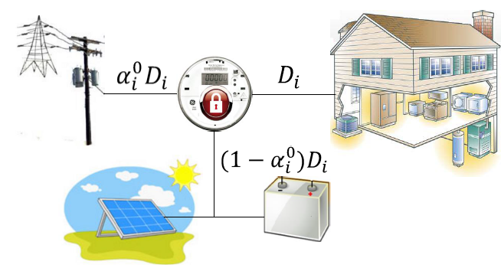
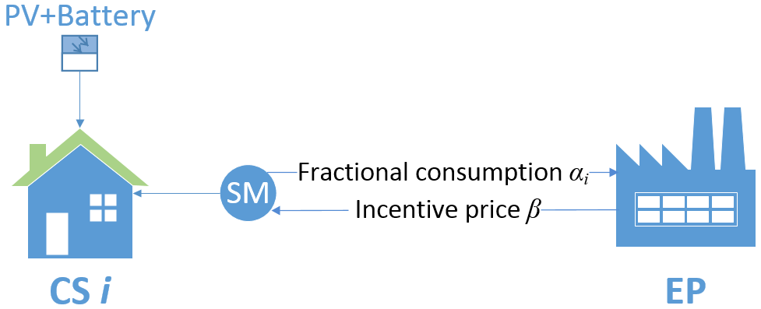
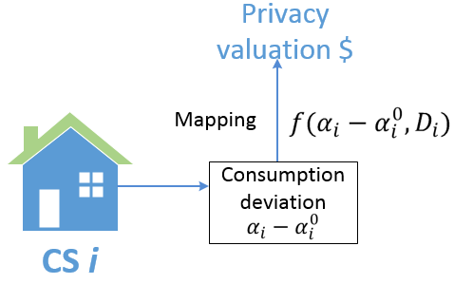
AMI: Privacy and Incentives
EPs need users to consume a desired level of energy directly from the grid for reliable grid operation
Is it possible to incentivize privacy-sensitive electricity CSs to share data via smart meters for reliable grid operation?
Each CS faces a trade-off between privacy and energy cost reduction
CS
CS
Inelastic net demand $D_{i}$
Privacy preserving mechanism: grid consumption $α_{i}^{0}D_{i}$
CS
EP
Adjust consumption to $α_{i}D_{i}$ based on incentive price $β$
  Offer price $β$($/KW) to encourage consumption from the grid
Notes:
CS i has inelastic net demand $D_{i}$
Without incentive, the privacy preserving mechanism determines consumption $α_{i}^{0}D_{i}$
However, this consumption $α_{i}^{0}D_{i}$ may not be sufficient for the EP
EP may offer incentive price $β$($/KW) to encourage consumption from the grid

Slide 29
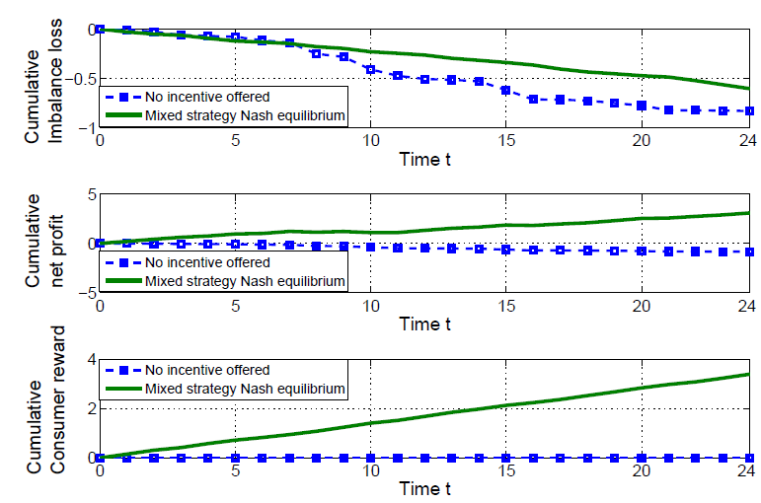
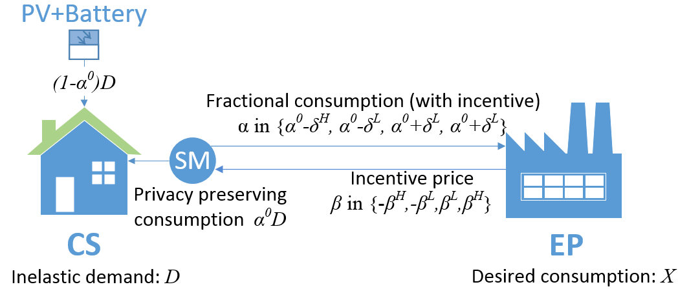
Game Theoretic Approach
Objective of CS: Gain from accepting incentives – Privacy loss
Objective of EP: Gain from improved operation – Cost of offering incentives
A two-player mixed strategy example:
Both utilities and consumers are happy for this particular model
Huang, Chong, and Lalitha Sankar. " Incentive mechanisms for privacy-sensitive electricity consumers with alternative energy sources." 50th Annual Conference on Information Systems and Sciences (CISS), Princeton, 2016.
Notes:
Quadratic loss functions: high penalty for energy imbalance
EPs can still continue to incentivize because the penalty for having energy imbalance in the grid is high

Slide 30
Competitive Privacy
Reliable monitoring of the grid requires data sharing between operators
Sharing limited information due to privacy or security reasons
Interactions between utilities can be modeled as a common goal game
Belmega, E. Veronica, Lalitha Sankar, and H. Vincent Poor. "Enabling data exchange in two-agent interactive systems under privacy constraints." IEEE Journal of Selected Topics in Signal Processing 9.7 (2015): 1285-1297.

Slide 31
Thank you!
http://sankar.engineering.asu.edu/
?

Slide 32
State of Art
False data injection attack (FDI) on state estimator:
Y. Liu, M. K. Reiter, and P. Ning, “False data injection attacks against state estimation in electric power grids,” Proceedings of the 16th ACM Conference on Computer and Communications Security, 2009.
Y. Mo and B. Sinopoli. False data injection attacks in cyber physical systems. In First Workshop on Secure Control Systems, Stockholm, Sweden, April 2010.
Kosut, L. Jia, R. J. Thomas, and L. Tong, “Malicious data attacks on the smart grid,” IEEE Transactions on Smart Grid, vol. 2, no. 4, pp. 645–658, 2011.
G. Hug and J. A. Giampapa, “Vulnerability assessment of AC state estimation with respect to false data injection cyber-attacks,” IEEE Trans. Smart Grid, vol. 3, no. 3, pp. 1362–1370, 2012.

Slide 33
State of Art
MiM attack on generation control:
S. Sridhar and M. Govindarasu, “Model-based attack detection and mitigation for automatic generation control,” IEEE Transactions on Smart Grid, vol. 5, no. 2, pp. 580–591, 2014.
J. Wei, D. Kundur, T. Zourntos, and K. Butler-Purry, “A flocking-based dynamical systems paradigm for smart power system analysis,” in Power and Energy Society General Meeting, 2012 IEEE, 2012, pp.1–8.
MiM attack on electric market:
L. Xie, Y. Mo, and B. Sinopoli, “Integrity data attacks in power market operations,” IEEE Transactions on Smart Grid, vol. 2, no. 4, pp. 659–666, 2011.
D.-H. Choi and L. Xie, "Impact analysis of locational marginal price subject to power system topology errors," in Smart Grid Communications (SmartGridComm), 2013 IEEE International Conference on, 2013.
L. Jia, J. Kim, R. J. Thomas, and L. Tong, “Impact of data quality on real-time locational marginal price,” IEEE Trans. Power Systems, vol. 29, no. 2, pp. 627–636, 2014.

Slide 34
State of Art
MiM attack on power system topology:
J. Kim and L. Tong, “On topology attack of a smart grid: Undetectable attacks and countermeasures,” IEEE Transactions on Smart Grid, vol. 31, no. 7, pp. 1294–1305, 2013.
M. A. Rahman, E. Al-Shaer, “Impact Analysis of Topology Poisoning Attacks on Economic Operation of the Smart Power Grid,” in Proceedings of IEEE Distributed Computing Systems (ICDCS), Madrid, Spain, July, 2014.
A. Ashok and M.Govindarasu, “Cyber Attacks on Power System State Estimation through Topology Errors,” in Proceedings of IEEE PES General Meeting, San Diego, CA, USA, July, 2012.
Implication Analysis for Cyber attack in power system:
J. Liang, O. Kosut, and L. Sankar, “Cyber-attacks on ac state estimation: Unobservability and physical consequences,” in IEEE PES General Meeting, Washington, DC, July 2014.
A. Teixeira, S. Amin, H. Sandberg, K. Johansson, and S. Sastry, “Cyber security analysis of state estimators in electric power systems,” in 2010 49th IEEE Conference on Decision and Control (CDC), 2010, pp. 5991–5998.
J. Zhang, L. Sankar and K. W. Hedman, "Implications of Cyber Attacks on Distributed Power System Operations," in CIGRE Grid of the Future Symposium, 2014.

