Slide 1
Rethinking electric power systems-
Data-enabled social-ecological systems
MIT-LL/MIT
Marija Ilic ilic@mit.edu (marija.ilic@ll.mit.edu)
Invited panel presentation at
Smart Grids and Energy Services
https://lidssmart2017.mit.edu/location/
May 12,2017

Slide 2
Outline
General notion of “smart grid” as an enabler of sustainable electric energy services in social-ecological systems (SES); key role of data-enabling
The key role in solving major societal problems
The challenge and opportunity – abstraction for novel modeling, simulation and design principles to support paradigm change
Difficult questions and possible solutions
Huge challenge and opportunity—novel simulators for rapid demonstration of paradigm changes and their implications (key need for collaborations)
An example of real-world complex grid (extra slides)

Slide 3
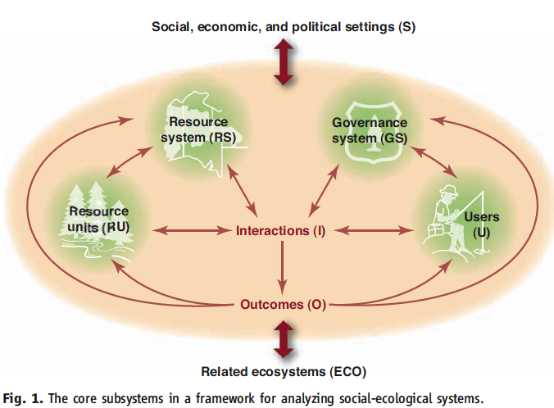
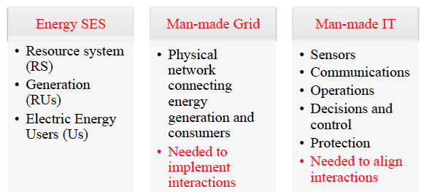
Smart grid—enabler of sustainable energy services
General social-ecological system (SES) [1]
“Smart grid”—enabler of social-ecological energy systems [2]

Slide 4
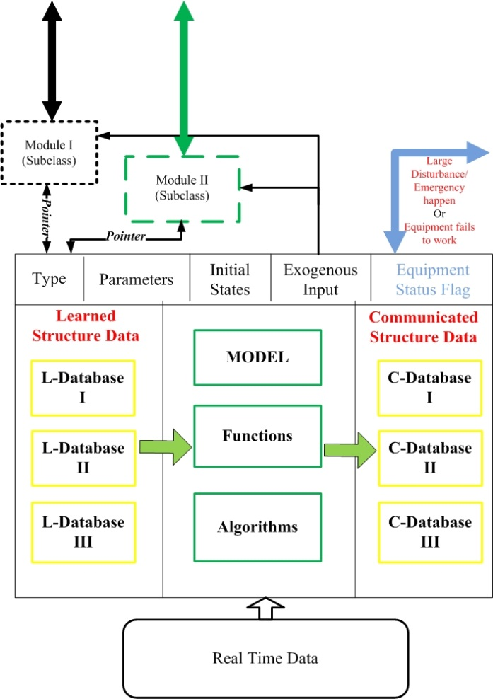
Abstraction-interacting decision makers
DIVERSE DECISION MAKERS—USERS; ISO; UTILITIES; LSEs;
NODES; EVs; OTHER DISTIRBUTED ENERGY RESOURCES (DERs)
Learned Data
Structure
Communicated
Data Structure
Charge requirements sent by driver simulation
EV Module
Processed to get bid functions and sent to EVLSE
Prices over a horizon sent by price-forecaster
SOC Sent to driver simulator
EXAMPLE OF AN EV AS A DECISION MAKER [3]
GENERAL (ABSTRACT) REPRESENTATION OF AN INTERACTIVE “SMART” DECISION MAKER

Slide 5
Smart grids--- modeling, analysis and design principles [2,6]

Slide 6
The key role of smart grids in solving societal problems
Ten key attributes determining sustainability of a complex SES [1]
size of resource; predictability of system dynamics; resource unit mobility; number of users; leadership; norms/social capital; knowledge of the SES; importance of resources to users; collective choice rules.
Conjecture (Ilic, 2017)
All these attributes can and should be shaped through data enabling (embedded intelligence into decision makers, and information exchange between them)

Slide 7
Avoiding “tragedy of the commons”
“…WHEN MANAGING RESOURCES EXCEEDS THE PERCEIVED COSTS OF INVESTING IN BETTER RULES AND NORMS FOR MOST OF USERS AND THEIR LEADERS; THE PROBABILITY OF SELF-ORGANIZING IS HIGH” [1]
Several institutional economists suggest:
IT plays fundamental role in managing tragedy of the commons problem---non-sustainable electric energy services (an example of tragedy of the commons problem)

Slide 8
Challenge in engaging consumers
Nobody knows their monthly electricity bill (too cheap, or socialized?— flat rates for non-differentiated services)
Theoretically impossible to prove to the end user that they are using “green” power (unless at their home); no mechanisms to implement choice
Utilities do not know users’ preferences; users generally inelastic (repeat INDEX [4] as ELDEX [5]; data gathering/analysis critical)
Short-term vs. long-term efficiency solutions (easier to by new refrigerator/insulate than to make the house smart)
Value provided by utilities/LSEs to consumers needs re-thinking (aggregation to reduce need for expensive hardware)

Slide 9
Difficult academic questions
Abstraction of the complex problem for analysis and design.
Aligning multiple objectives--physical, economic, financial and environmental performance (integration of technologies and systems solutions at value) [6]
Aligning sub-objectives of distributed decision makers and system-level objectives
Methods for on-line flexible system management (beyond worst case approaches to socialized reliability)
Challenges different across temporal and spatial scales
-potentially unstable dynamics in small grids with persistent multi-scale disturbances (fundamental limit to using clean resources) (tightly coupled, nonlinear modules--control design/standardization needed)
-lack of market signals for managing dynamics and uncertainties at value

Slide 10
The role of academic research
Educate starting from existing problems and using abstractions/methods to be used in the future (identify exciting open problems and solutions)
Provide thought leadership to the industry toward changing industry paradigm from grid-centric to consumer-centric and the role of data-enabled approaches (beyond hardware)
Pose key problems of designing cyber-physical systems in support of sustainable electric energy services as large IDSS problems
Lead the way in modeling and analysis/design principles required; build scalable simulators/visualization in support of new pradigms
Work toward generalized abstractions of the problem which can be posed and related (translated) in context of today’s industry practice—build on existing SCADA and not start from scratch (for example)
Huge challenges and opportunities to help industry/have impact

Slide 11
Huge opportunity—novel simulators for rapid analysis and design using systematic abstractions
Collaborations key: NSF-JST-DFG
Microgrid Controller
CMU-MIT-MIT/LL
SGRS Platform
Simulated 1 MVA Genset
Simulated 4 MVA Genset
Simulated Solar PV system
Simulated Energy storage system
Simulated Induction motors
DAMPS Implementations
Simulated Banshee
(CAMPS [7,8] implementation)
Simulated distribution network
Simulated Sheriff
(CAMPS implementation)
Centralized Simulations (CAMPS)
Multi-core distributed Simulations
(DAMPS)

Slide 12
Publications
[1] Elinor Ostrom, et al, A General Framework for Analyzing Sustainability of social-Ecological Systems, Science 325, 419 (2009)
[2] Ilic, M., Dynamic Monitoring and Decision Systems for Sustainable Electric Energy, Proc of the IEEE, Jan 2011
[3] J.Donadee, M.Ilic, “Stochastic optimization of grid-to-vehicle frequency regulation capacity bids”, IEEE Trans. on Smart Grids, Feb 2014.
[4] R.Edell, P. Varaiya, “ Providing internet access: what we learn from INDEX”, IEEE Network, Sept/Oct 1999.
[5] Model-based protocols for the changing electric power industry, PSCC, Sevilla, Spain, June 2002.
[6] Ilic, Marija, Toward a Unified Modeling and Control for Sustainable and Resilient Electric Energy Systems, Foundations and Trends in Electric Energy Systems, Vol. 1, No. 1 (2016) 1–14, DOI 10.1561/3100000002
[7] M. R. Wagner, K. Bachovchin, and M. Ilic, Computer architecture and multi time-scale implementations for smart grid in a room simulator, IFAC-PapersOnLine, vol. 48, no. 30, pp. 233–238, 2015
[8] ] Ilic, M, et al, A Decision Making Framework and Simulator for Sustainable Electric Energy Systems, The IEEE Trans. On Sustainable Energy, TSTE-00011-2010, January 2011.

Slide 13
THANK YOU

Slide 14
Additional slides

Slide 15
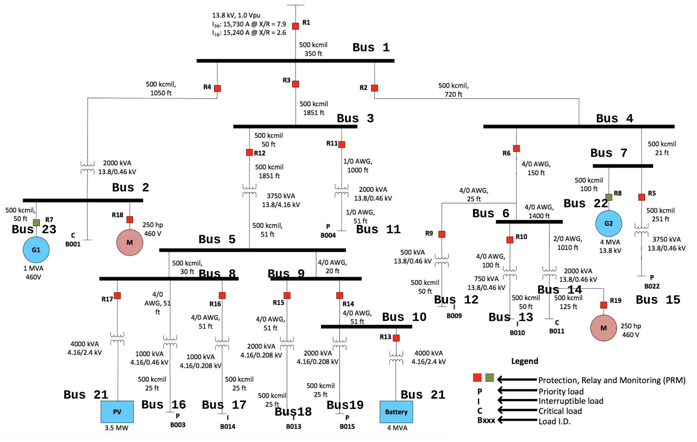
Complex electric power system
—Example of Sheriff distribution system [MIT LL repository]
CRITICAL LOADS
PRIORITY LOADS
Interruptible LOADS

Slide 16
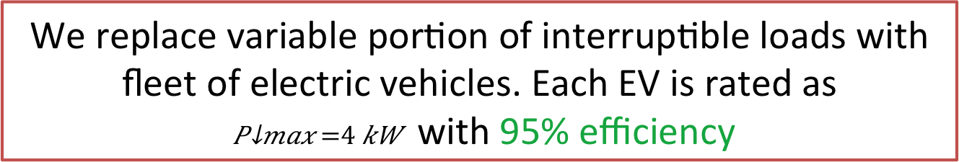
Load Profile
Type of Load | Minimum Loading |  |  |  | Maximum Loading
 | Real Power |  | Reactive Power |  | Real Power |  | Reactive Power
 | Absolute Demand (in MW) | % of total Demand | Absolute Demand (in MW) | % of total Demand | Absolute Demand (in MW) | % of total Demand | Absolute Demand (in MW) | % of total Demand
Priority | 0.99 | 36.14 | 0.44 | 57.33 | 3.90 | 50.39 | 1.93 | 60.25
Critical | 1.01 | 37.15 | 0.21 | 27.79 | 1.18 | 15.30 | 0.81 | 25.21
Interruptible | 0.73 | 26.70 | 0.11 | 14.88 | 2.65 | 34.31 | 0.47 | 14.54
Total | 2.73 |  | 0.76 |  | 7.73 |  | 3.21
Interruptible loads constitute 26 – 35% of total real power demand at any time instant.
This defines the synthetic reserve capability of this grid
We replace variable portion of interruptible loads with fleet of electric vehicles. Each EV is rated as
with 95% efficiency

Slide 17

Interdependencies with transportation– EV participation
CRITICAL LOADS
PRIORITY LOADS
Interruptible LOADS

Slide 18
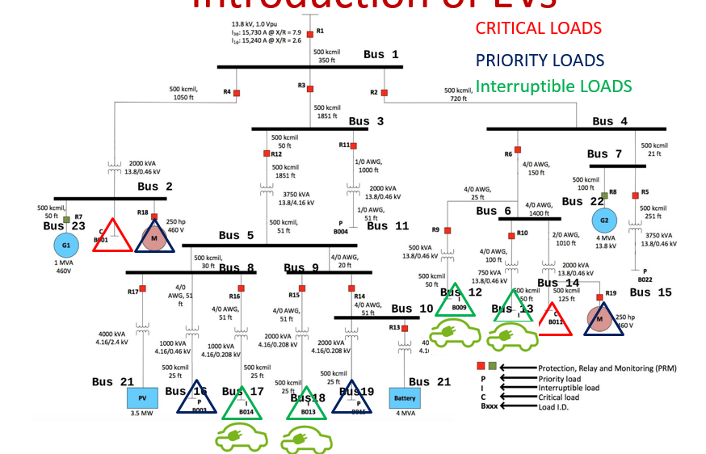
Sheriff as a single NODE – Introduction of EVs
Bus No. | Mean value of Inflexible load (in MW) | Aggregate EVLSE power demand (in MW) | No. of EVs
12 | 0.145 | 0.784 | 206
13 | 0.205 | 0.724 | 191
17 | 0.156 | 0.09 | 24
18 | 0.221 | 0.325 | 86
Total | 0.727 | 1.923 | 507

Slide 19
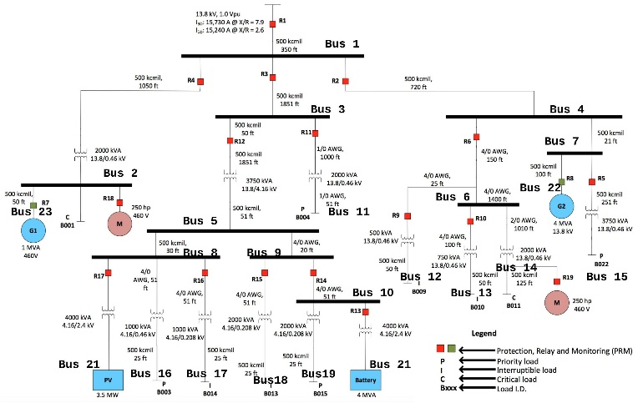
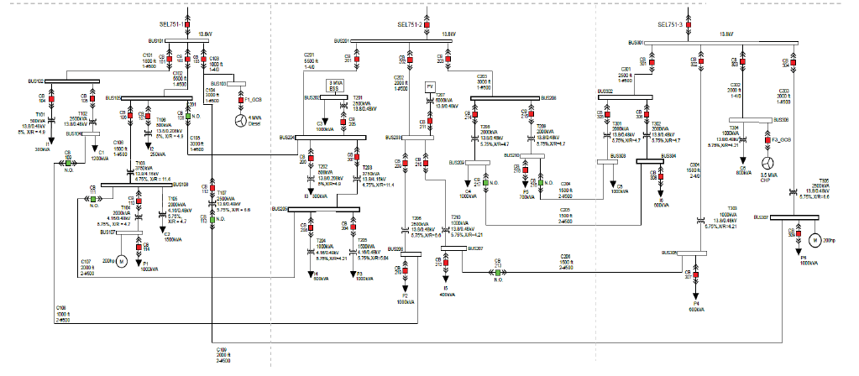
Utility interconnected to several Network Optimized Distribution Energy Systems (NODES)
UTILITY BUS
NODE 1
NODE 2
SHERIFF GRID
BANSHEE GRID

Slide 20
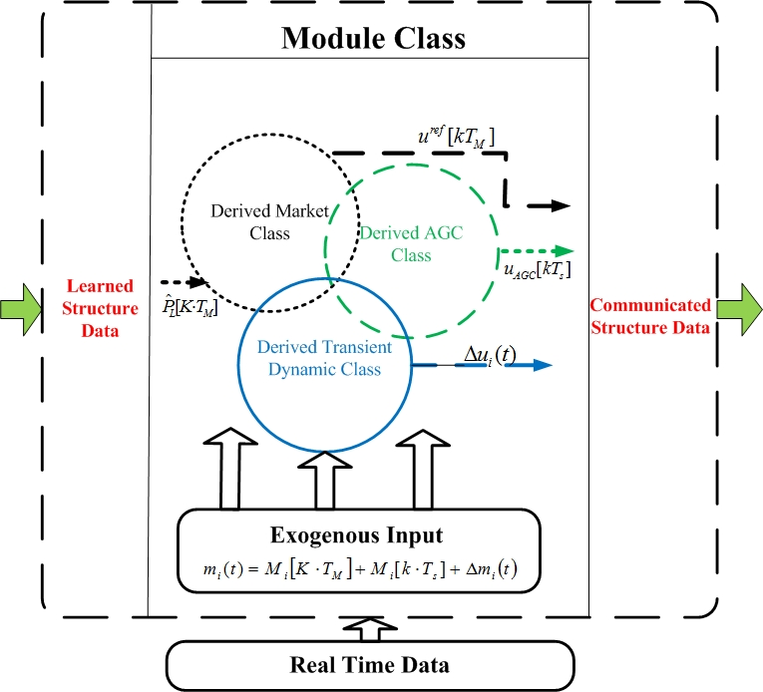
Information flows to NODES
—and from NODES to utility markets
No fast system-wide information exchange at present
Notes:
This slide is critical for understanding the scalability and generality of the SGRS under development. Observe that each exogenous input entering specific module has three separable components, predictable component (day ahead, hour ahead, 10 minutes ahead); hard-to-predict component which contributes to frequency distortion during normal operation; and very fast disturbance (small or large) which requires fast automation to ensure the system remains stable when this disturbance occurs. General DyMonDS protocol requires that each module has cyber to counteract all three types of exogenous inputs. Each module has a derived class for managing predictable input (market participation, or scheduling in regulated industry); as well as two other derived classes, one for AGC and one for stabilization. Standards in support of all these controllers must be in place for the interconnected system to have desired response. Recall from Slide 2 that market clearing requires system-wide information exchange;; this results in reference schedule given to derived market class of each module. Luckily, both AGC and stabilization can be shown to require only distributed information exchange. This makes the fast time scale simulator distributed and therefore this part of the platform is implemented using parallel algorithms. It is explained in part in the report and other references are available for full explanation of how this works.

