Slide 1
Coordinating Energy Resources
Ram Rajagopal
Stanford University

Slide 2



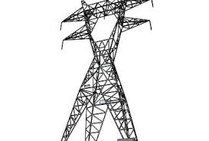
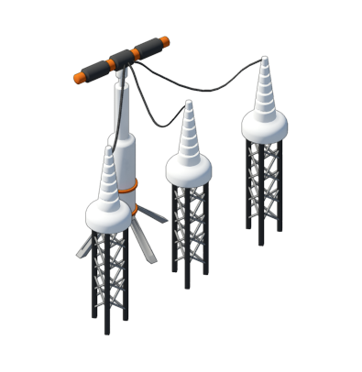

Changing Electricity Grid
Grid System Operator
(Federal Regulations)
Electricity Utility
(State Regulation)
Wholesale
Market
Utility
$
Generation
METER
Customer
Transmission
Substation
Distribution

Slide 3


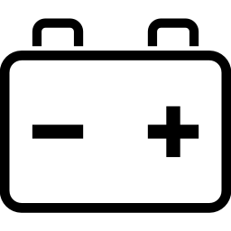
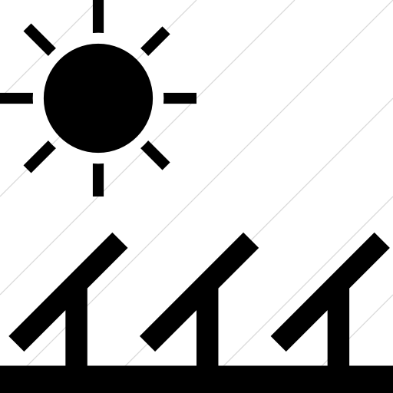
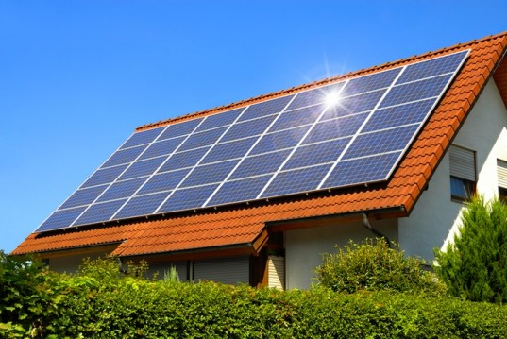
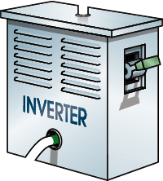
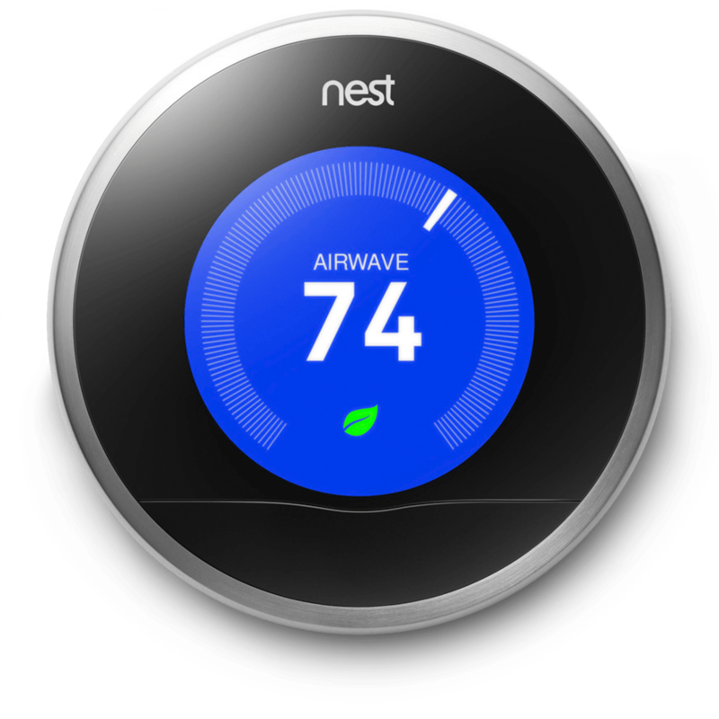
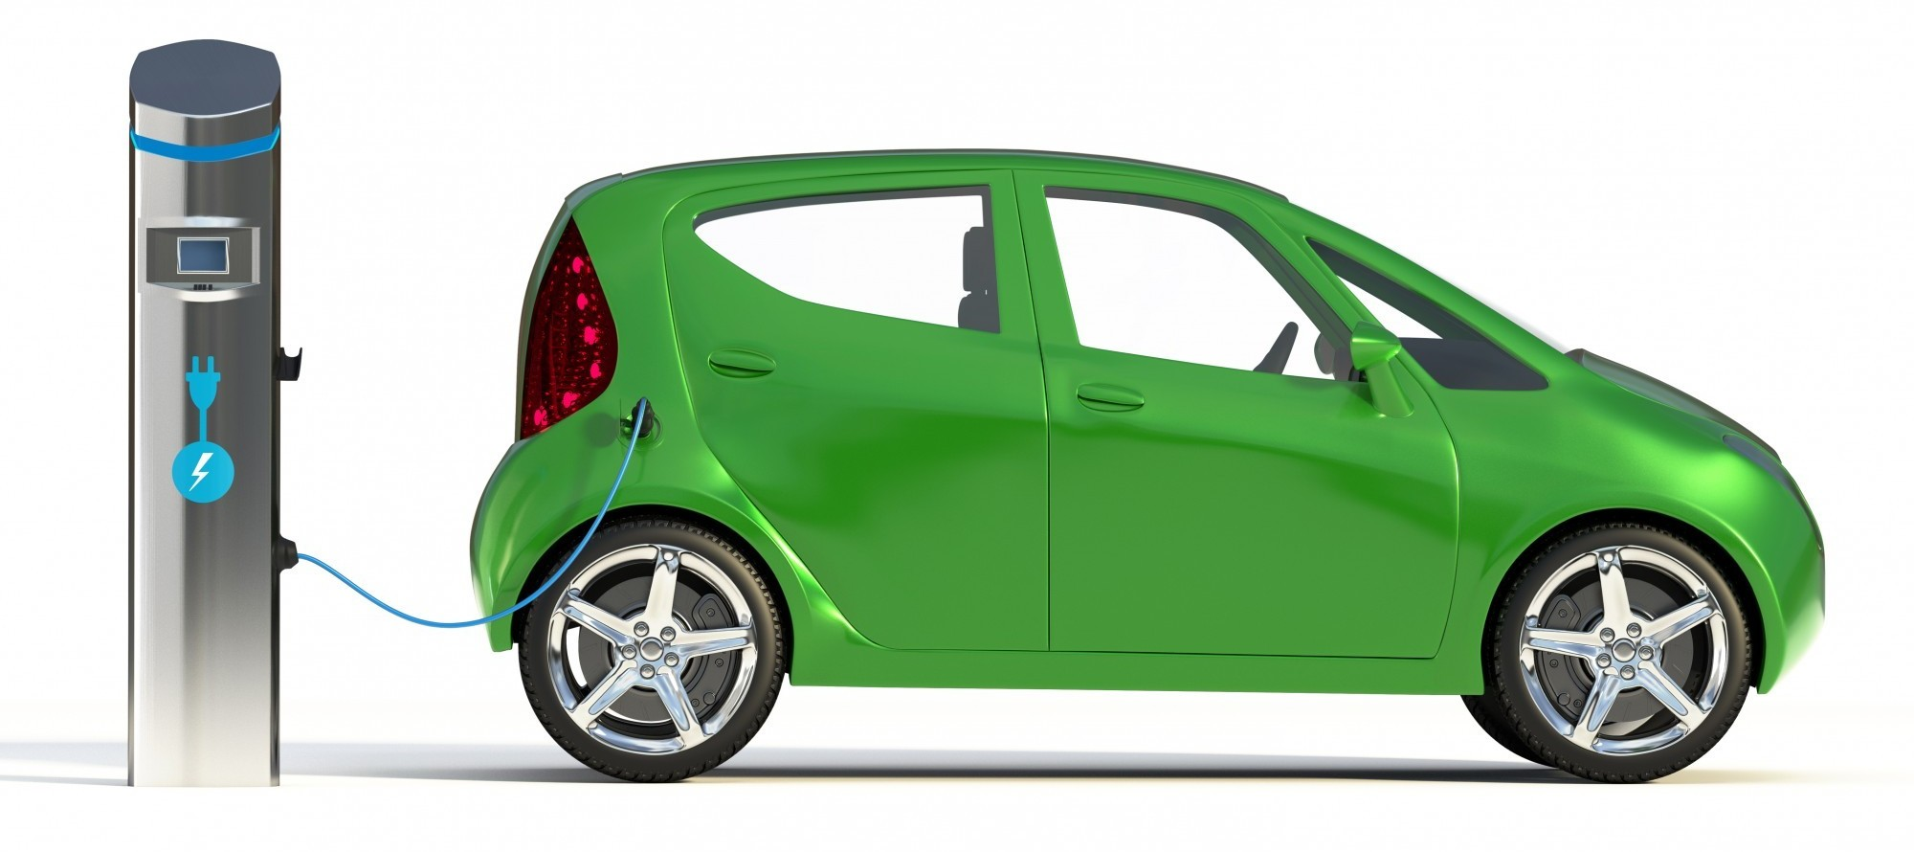
Changing Electricity Grid
Private PV
Cloud
Private EV
Cloud
Private
Thermostat
Cloud
Grid System Operator
(Federal Regulations)
Electricity Utility
(State Regulation)
Wholesale
Market
Utility
>50%
$
Generation
METER
Customer
Transmission
Substation
Distribution
Notes:
How to engage this DER resources to support the ecosystem?

Slide 4

Key concerns
Scaling residential load control:
  Can distributed resources be coordinated at scale?
  How to make it attractive and easy for consumers to engage?
Diversity of coordination needs
  Bilateral agreements between trusted industrial parties
  Volatile resource engagement (no transmission aggregation effect)
  Distribution network service provision
Distribution network information availability
APEX

Slide 5










Powernet: coordinating from the cloud
Cloud
Coordination
Load
Subcircuits
Smart Dimmer
Home
Hub
Network
Controlled
Loads
Local Intelligence
Feedback
Power
Markets
Automate response to prices while preserving privacy and reliability
Coordinate homes to shave peaks and provide grid services
Enable smart homes and buildings
Stanford/SLAC: Aaron Goldin, Gustavo Cezar, Junjie Qin, Thomas Navidi, Matt Kiener, Yuting Ji, Jonathan Goncalves, Abbas El Gammal, Arun Majumdar, Steven Chu, Sila Killicote, Claudio Rivetta, David Chassin.

Slide 6

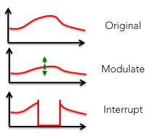
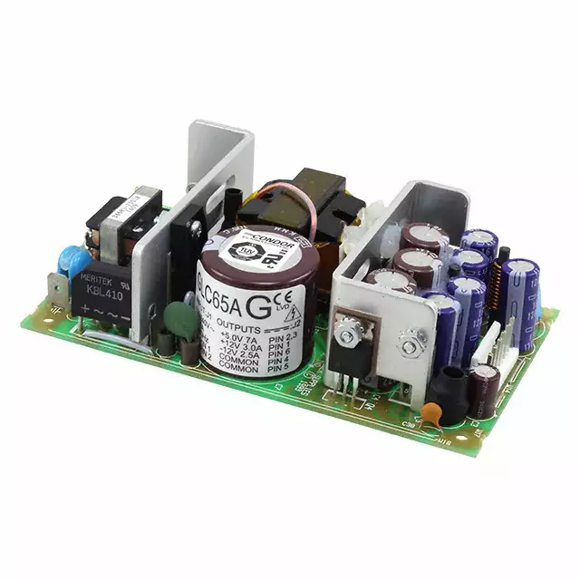

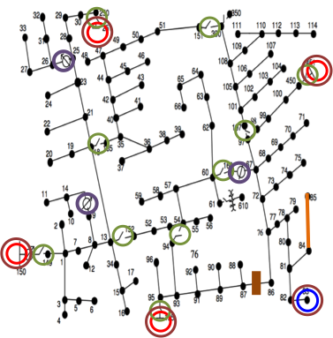
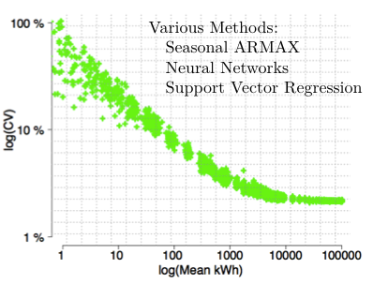
What is inside Powernet?
Global
Optimization
Delay
Home
Hub
Home
Hub
Home
Hub
Smart Dimmer
Distributed Intelligence and Optimization
Predictive and Diagnostic Analytics
Hardware and Systems in the loop

Slide 7
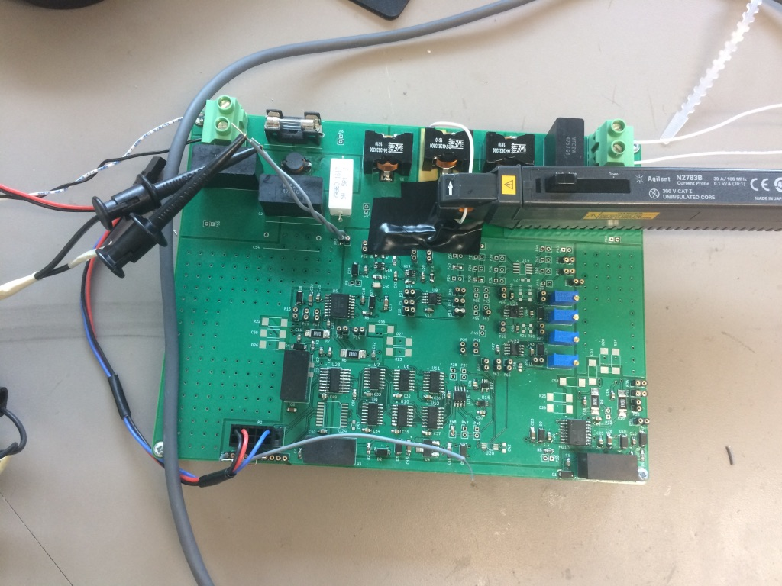
Smart Dimmer
Connect/disconnect power to load
  Response of 100µS or less
  Interrupt inductive load
Reduce output voltage
  Accurate within 1%
  Reduce power consumption of resistive load by 10% or greater
  Control arbitrary load (R, L, C, nonlinear)
Operate at 120V or 240V
Signal processing and machine learning to identify load models

Slide 8
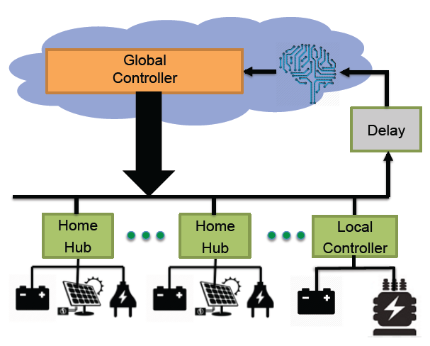
New Distributed Storage Controller
Increases solar PV penetration to
30% from 10% without coordination
Captures close to 80% of arbitrage profit of a perfect foresight controller
These benefits are achieved
with hourly updates between
local and global controllers
*K. Anderson, R. Rajagopal, and A. El Gamal, “Coordination of distributed storage under temporal and spatial data asymmetry,” submitted to IEEE Trans. On Smart Grid.

Slide 9
Cyber, physical and economic requirements for coordination

Slide 10
Theory: Contingent Multilateral Trades
Observation: Under various assumptions contingent trade can be replaced by open gate
J. Qin, R. Rajagopal, P. P. Varaiya, “Flexible Market for Smart Grid: Coordinated Trading of Contingent Contracts”, Submitted to IEEE Transactions on Control of Network Systems.

Slide 11
Automatic Power Exchange
Ensures satisfaction of physical constraints; supports volatile resources and load flexibility
Collaborators: Junjie Qin (Stanford), Jonathan Mather (Berkeley), Raffi Sevlian (Stanford), Louis Badouin (Stanford), David Chassin (SLAC), Kameshwar Poolla (Berkeley), Pravin Varaiya (Berkeley),

