Slide 1

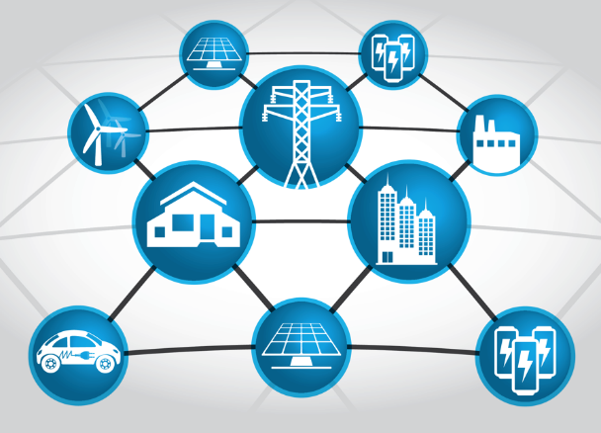

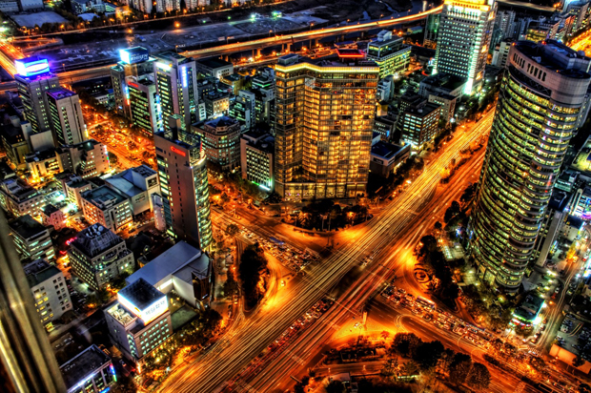
Smart Grid – Controlling the Edge
Dr. Sonja Glavaski, Program Director

Slide 2
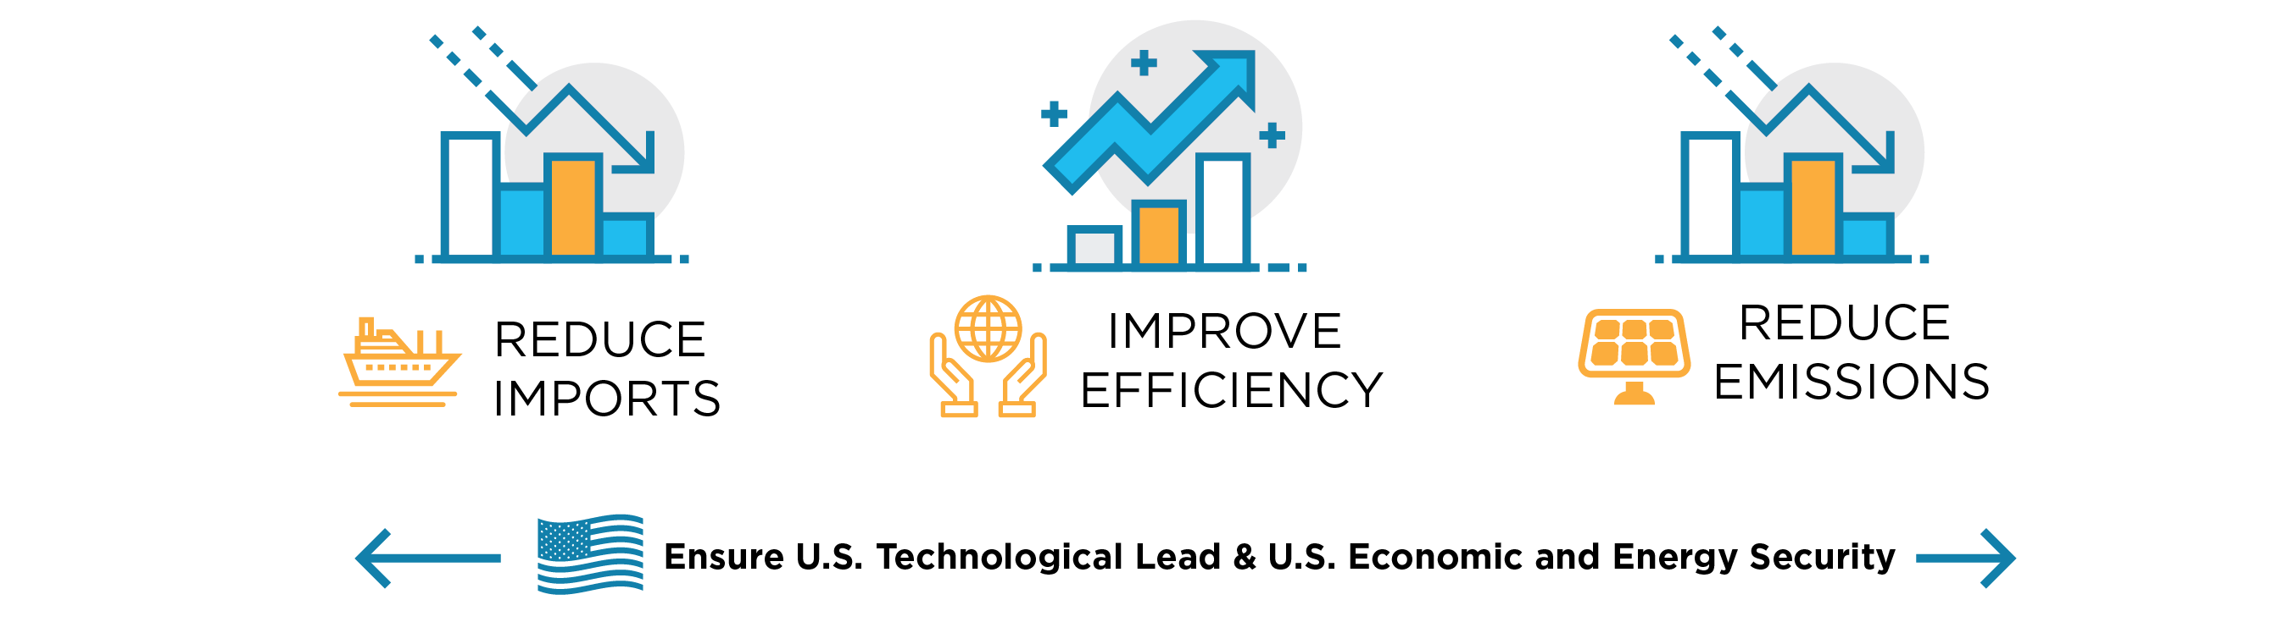
Mission & History of ARPA-E
Mission: To overcome long-term and high-risk technological barriers in the development of energy technologies
Coming
soon
500+
39
32
23
Awards Announced
37
20
16
12
Programs
To Date
7
1
2007
Rising Above
the Gathering Storm
Published
2009
American Recovery & Reinvestment Act Signed
2010
2011
2012
2013
2014
2015
2016
2017
America COMPETES
Reauthorization Signed
America COMPETES
Act Signed
$275 Million
(FY2012)
$280 Million
(FY2015)
$400M
(Recovery Act)
$180M
(FY11)
$275M
(FY12)
$251M
(FY13)
$280M
(FY14)
$280M
(FY15)
$291M
(FY16)
$280M
(FY14)
Notes:
Updated to reflect 2015 numbers
Budget (Million) Data Source:
FY2009: $15,000 http://energy.gov/sites/prod/files/FY11Orgsum.pdf ARRA $388,856 http://energy.gov/sites/prod/files/FY11Orgsum.pdf (Note: rounded to $400 million in all public documents, did so here to maintain consistency.)
FY2010 $0 http://energy.gov/sites/prod/files/FY11Orgsum.pdf
FY2011 $179,640 http://energy.gov/sites/prod/files/FY13Volume4.pdf (p. 401)
FY2012 $275,000 http://energy.gov/sites/prod/files/2013/04/f0/orgsum.pdf
FY2013 $250,636 http://energy.gov/sites/prod/files/2014/04/f14/FY%202015%20DOE%20Budget%20by%20Organization.pdf
FY2014 $280,000 http://energy.gov/sites/prod/files/2015/01/f19/FY2016BudgetSummaryTableByOrg_0.pdf
F2015 $279,982 http://energy.gov/sites/prod/files/2015/01/f19/FY2016BudgetSummaryTableByOrg_0.pdf
FY2016 (Requested) 325,000 http://energy.gov/sites/prod/files/2015/01/f19/FY2016BudgetSummaryTableByOrg_0.pdf

Slide 3





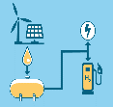
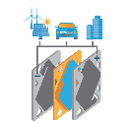

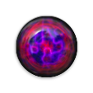



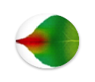








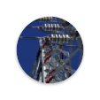





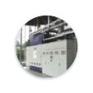







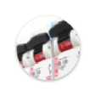
Focused Program Portfolio
Electricity
Generation
Efficiency &
EMISSIONS
Transportation &
Storage
Grid &
Grid storage
Mosaic
GENSETS
ENLITENED
ROOTS
NEXTCAR
REFUEL
IONICS
GRID DATA
Active
alpha
delta
SHIELD
Transnet
TERRA
Nodes
Rebels
focus
Monitor
arid
Range
Remote
charges
geni
Alumni
Solar Adept
Switches
Metals
Move
Petro
Heats
Impacct
React
beetit
Adept
ElectroFuels
amped
beest
Grids
OPEN 2009, 2012, & 2015 Solicitations
Complement Focused Programs

Slide 4
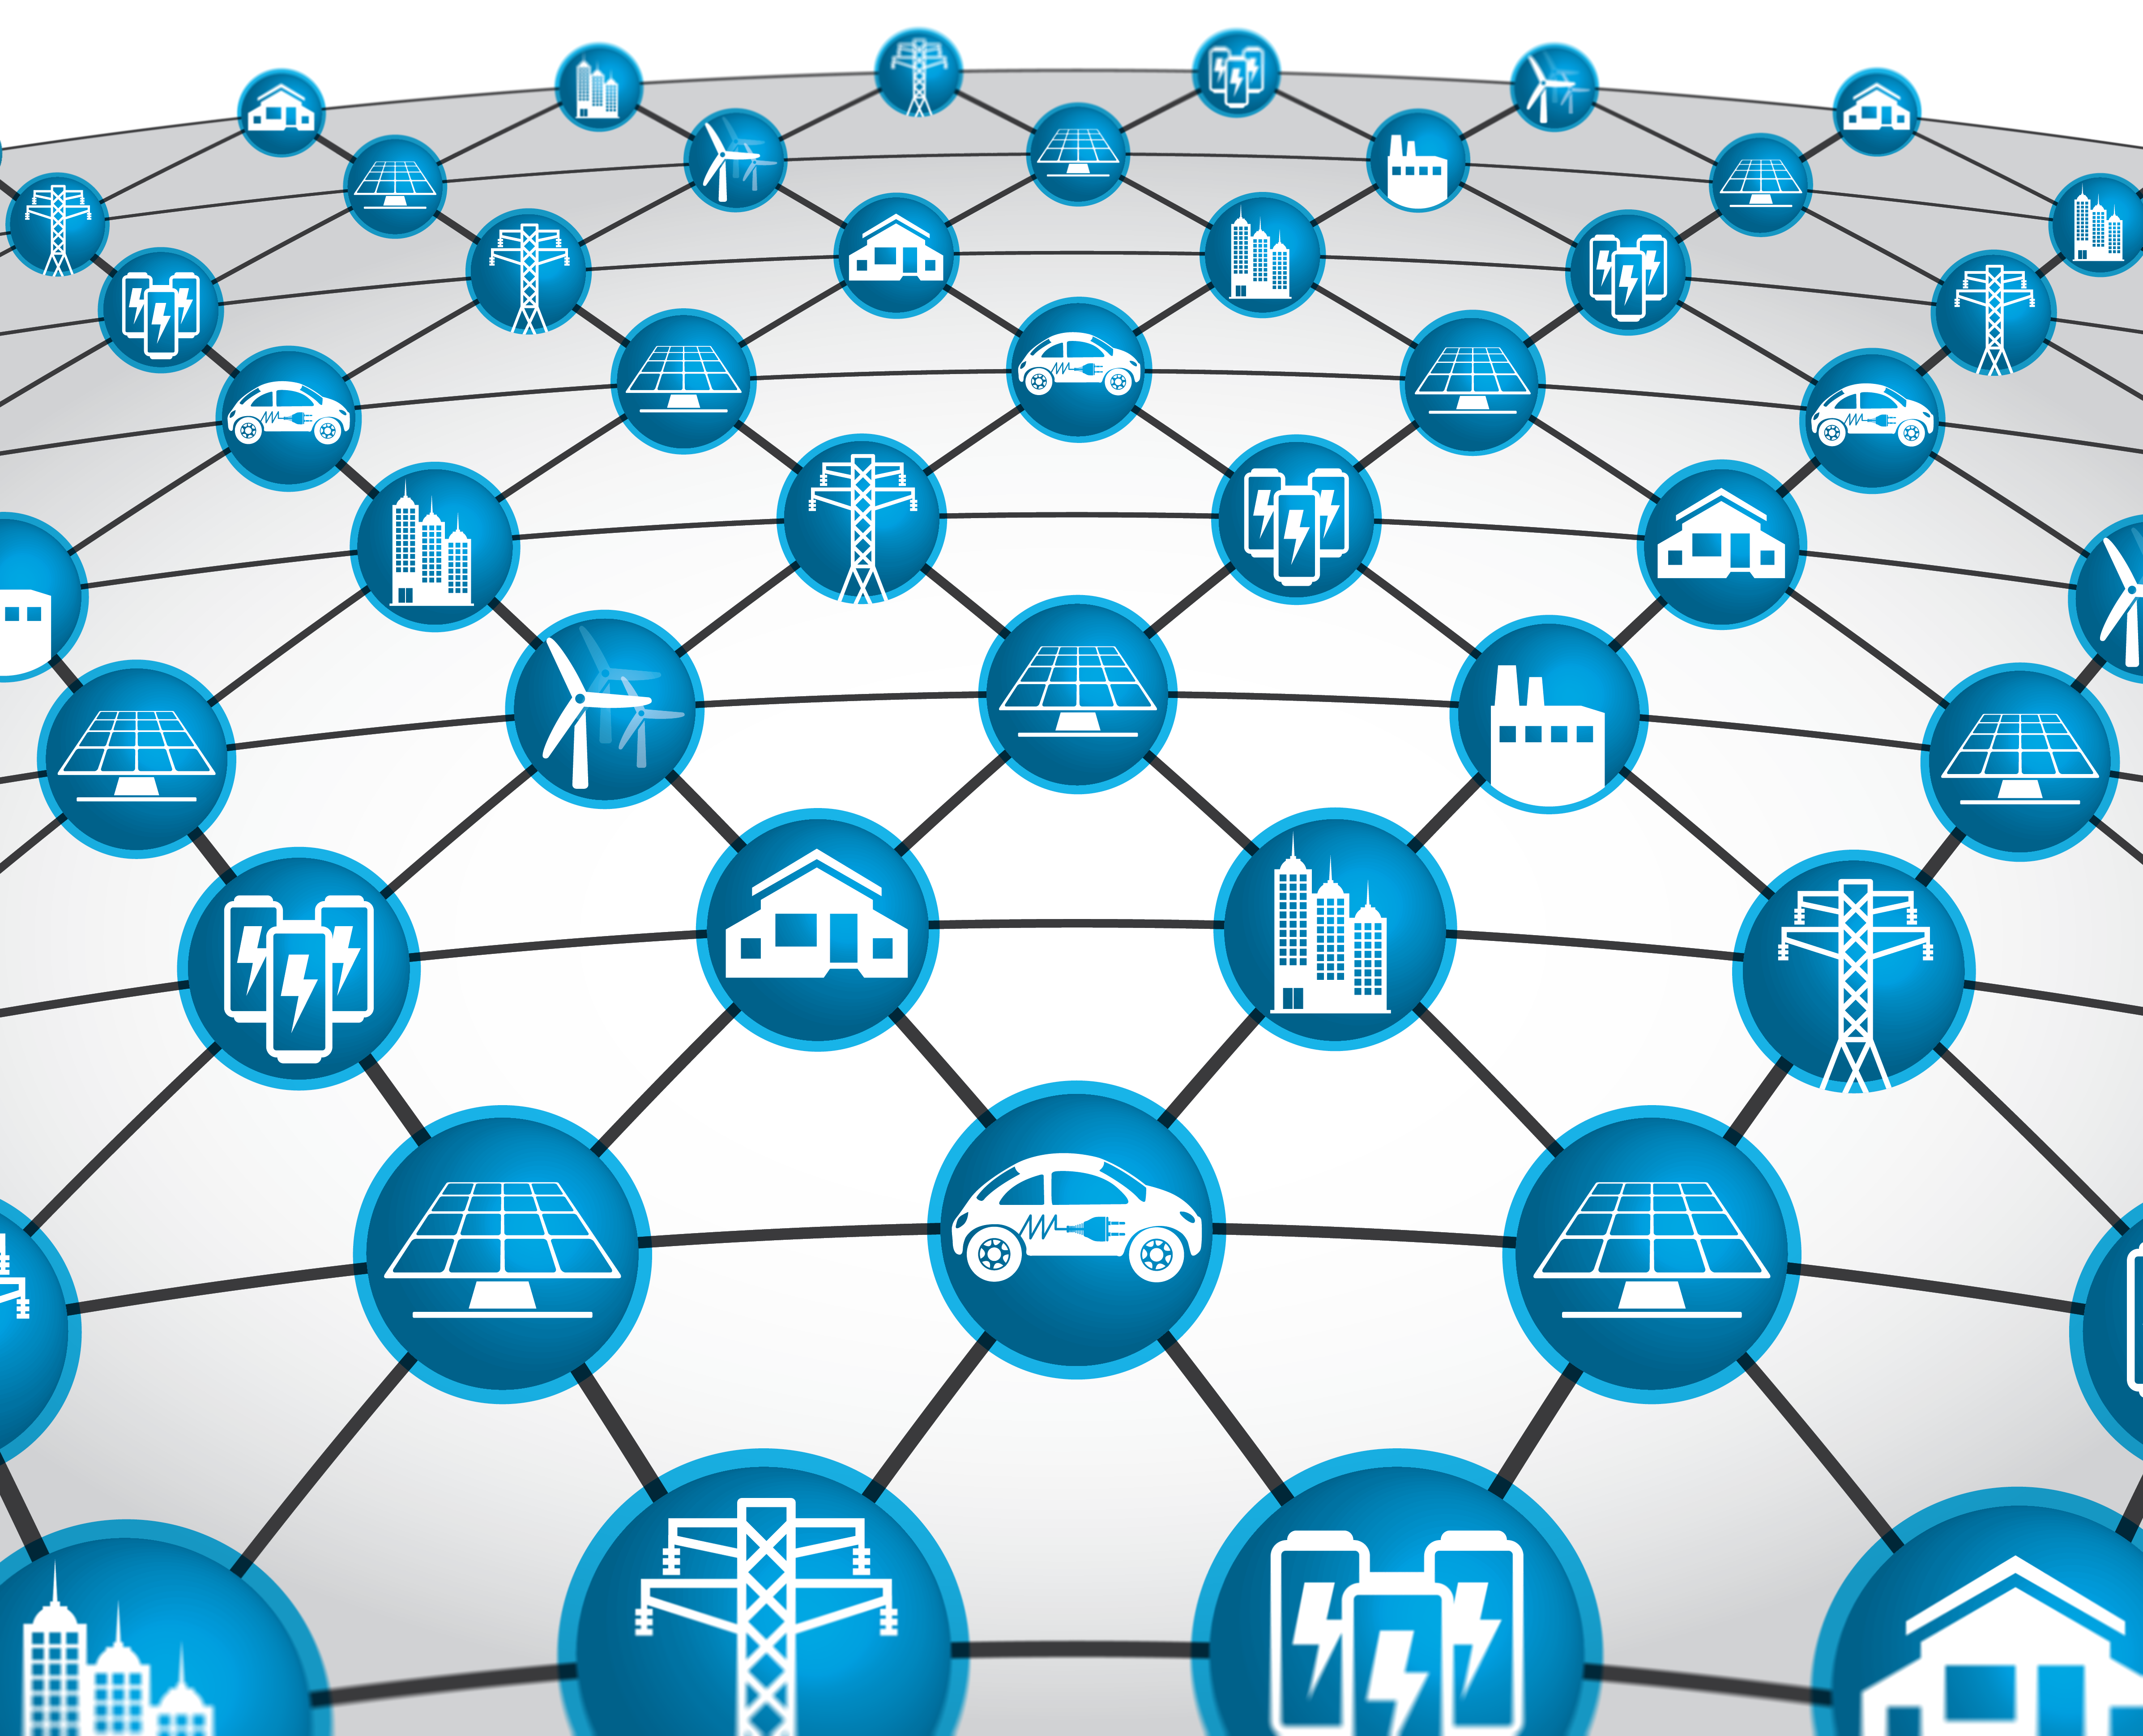
U.S. Power Grid

Slide 5
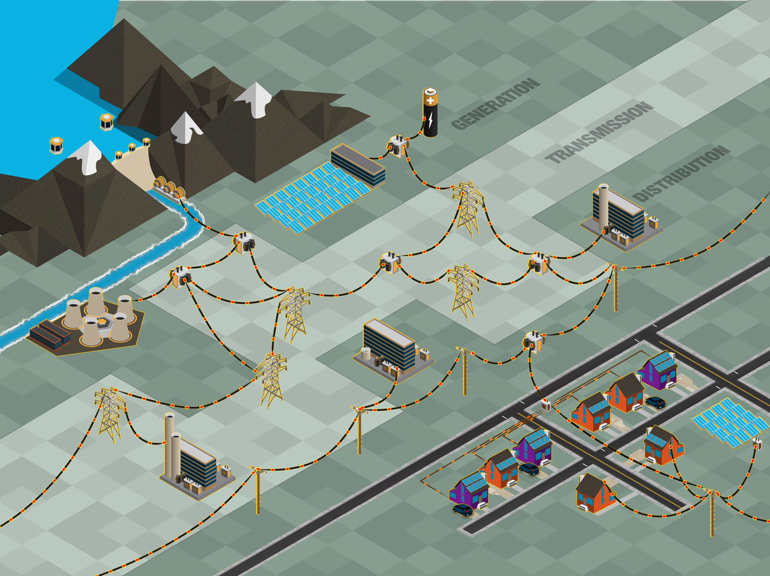
US Grid Today in Few Words
STORAGE
DISPATCHABLE
RENEWABLE
GENERATION
NON-DISPATCHABLE
RENEWABLE
GENERATION
DISPATCHABLE
GENERATION
DISTRIBUTED ENERGY RESOURCES (DERS)
Top down management
Control generation to match load
Distribution treated as net-load
Planning for highest peak load
Notes:
The Grid: Bulk generation, transmission, distribution,
The dominant paradigm for delivering electricity in the U.S. consists primarily of bulk electricity generation at central power plants, followed by transport across the U.S. electrical grid via transmission and distribution (T&D) networks, and finally delivery to the end-user.
Bulk Generation
dispatchable thermal generation (nuke, coal, NGCC),
dispatchable renewables (hydro), and
non-dispatchable renewables (solar, wind)
The addition of intermittent generation along with changing usage patterns (e.g. increased penetration of electric vehicles) is leading to greater uncertainty and variability in the electric grid.

Slide 6
Grid Reliability - Frequency Stability
Directly affected by generation-demand balance
System Frequency
Contingency Event
60 Hz
Slope ∝ System inertia
Settling Frequency
Frequency Nadir
~59.5 Hz
UFLS Threshold
0 s
5-10 s
20-30 s
5-10 min
Time
Primary Frequency Ctrl
Automated Generation Control (AGC)

Slide 7
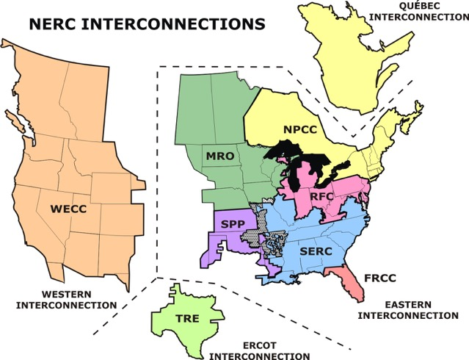
Who Manages U.S. Grid Reliability?
3 primary electric grids in US
8 regional entities managing electricity reliability

Slide 8
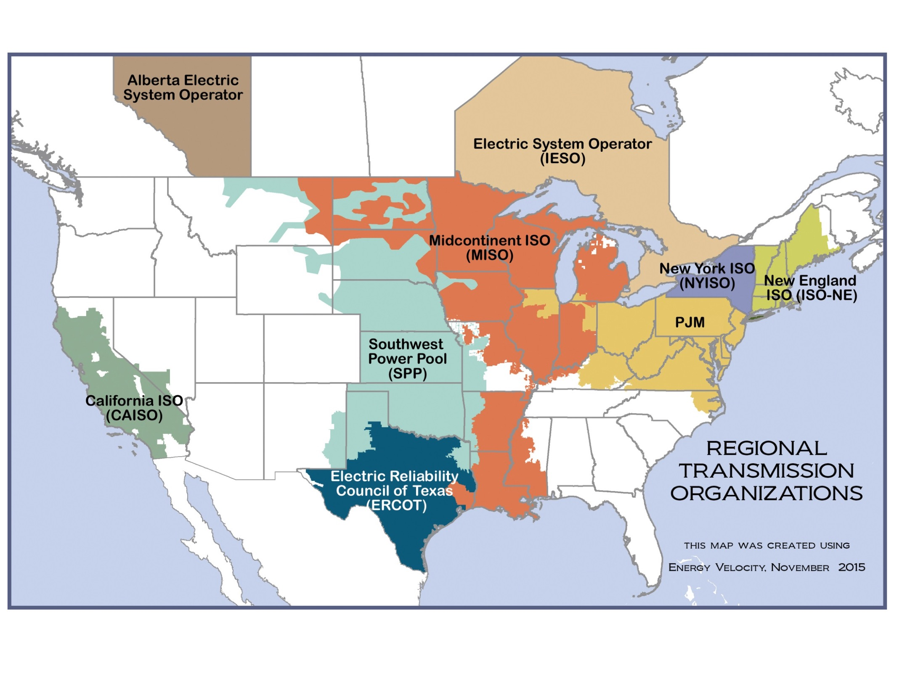
Who Oversees U.S. Whole Sale Markets?
RTO/ISOs
Operate the transmission grid
Dispatch electricity based on marginal cost bids

Slide 9

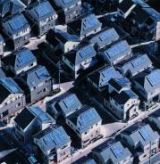

U.S. Power Grid is Changing!
CAISO opening markets to DERs (50% by 2030)
NY Reforming the Energy Vision to increase renewables & DERs (50% by 2030)
Hawaii to use only renewable power within the next 30 years (100% by 2045)
Vermont to use mainly energy from green sources (90% by 2050)
29 States + Washington DC have a Renewable Portfolio Standard (8 states have renewable portfolio goals)
WA: 15% x 2020*
MT: 15% x 2015
ND: 10% x 2015
MN:26.5%
x 2025 (IOUs)
31.5% x 2020 (Xcel)
OR: 25%x 2025*
(large utilities)
SD: 10% x 2015
WI: 10% 2015
NY: 29% x 2015
MI: 10% x 2015*†
IA: 105 MW
OH: 12.5% x 2026
NV: 25% x
2025*
UT: 20% x 2025*†
IL: 25% x 2026
IN: 10% x 2025†
CO: 30% by 2020 (IOUs) *†
VA: 15% x 2025†
CA: 50%
x 2030
KS: 20% x 2020
MO:15% x 2021
NC: 12.5% x 2021 (IOUs)
AZ: 15% x 2025*
OK: 15% x 2015
SC: 2% 2021
Renewable portfolio standard
NM: 20%x 2020 (IOUs)
TX: 5,880 MW x 2015*
Renewable portfolio goal
HI: 100% x 2045

Slide 10
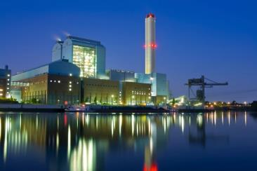
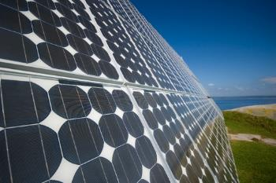



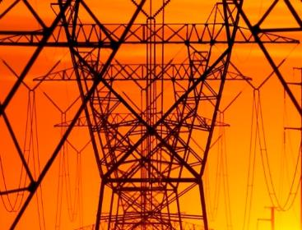
Grid Change Brings Challenges
Dispatched generation
Intermittent DG
Predictable load
Variable
Net-Load
Capacity available
Capacity constrained
Renewables penetration is limited (< 30%) because of lack of capability to reliably and affordably manage its variability

Slide 11
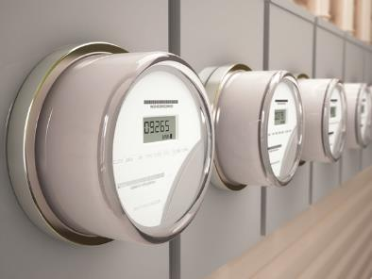

Emerging Grid Operation Paradigms
ISO & DER aggregators
  ISO manages transmission & wholesale
  Aggregated DERs bid into bulk market
ISO & DSO
  ISO manages transmission & wholesale
  DSO manages distribution & retail
Network of micro-grids
  Power supplied locally
  Grid supplies backup power

Slide 12
Network Optimized Distributed Energy Resources (NODES) Program

Slide 13

If we can actively control Net-Load,
50% renewable integration is possible.

Slide 14
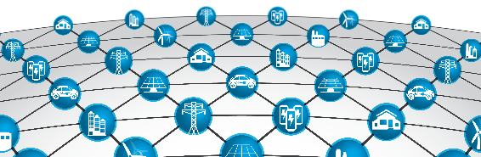
NODES
Network Optimized Distributed Energy Systems
Mission
Reliably manage dynamic changes in the grid by leveraging flexible load and Distributed Energy Resources’ (DERs) capability to provide ancillary services to the electric grid at different time scales.
Goals
Enable renewables penetration at > 50%
Improve overall grid efficiency & reliability
Reduce CO₂ emissions
Guarantee Level-of-Service to the Grid
Guarantee customers’ QoS
Project Categories | Response Time | Ramp Time | Duration
C1: Synthetic Frequency Reserves | < 2 sec | < 8 sec | > 30 sec
C2: Synthetic Regulating Reserves | < 5 sec | < 5 min | > 30 min
C3: Synthetic Ramping Reserves | < 10 min | < 30 min | > 3 hr

Slide 15





Category 1: Synthetic Frequency Reserves
Objective
Increase “inertia” in the system
Approach
Load providing inertial response while
using local measurements
Challenges
Guarantee stability of the system
Guarantee improvements of
frequency compared to the
traditional generation control only
Response speed
Validation
HIL validation with a minimum of 100 actual devices at power
Large-scale simulation (optional) to demonstrate the robustness and scalability
Inertial Response
Droop Control

Slide 16






Category 2: Synthetic Regulating Reserves
Objective
Support frequency recovery/stability of the system
Approach
Use coordinated net-load control to
adjust magnitude and shift in time
Challenges
Coordination of large number of
heterogeneous energy resources
Understanding trade-off between
peer-to-peer communication and
optimal performance
Validation
HIL validation with a min of 100 actual devices at power
Large-scale simulation (optional) to demonstrate the robustness and scalability
Droop Control
If successful, load adjustment + shift could help
enable 50% renewables at 92% utilization

Slide 17

Category 3: Synthetic Ramping Reserves
Objective
Coordinated long term shifting of load with thermal/electric
storage (buildings, warehouses), and non-critical load
(pool pumps, PEVs) to reduce curtailment of renewables
Approach
Forecasting aggregated loads capacity
Supervisory control enabling load
balancing signal tracking
Challenges
Modeling and control of
a populations of controlled loads
Determining control requirements for
guaranteed aggregate load performance
Validation
Large-scale simulation to demonstrate the robustness and scalability
Droop Control
If successful, load adjustment + shift (>10%) could enable 50% renewables at 95% utilization

Slide 18












































NODES Project Portfolio
Category 1: Synthetic Frequency Reserves
Category 3: Synthetic Ramping Reserves
Category 2: Synthetic Regulating Reserves

Slide 19
NODES Projects by Team Lead Geography
PNNL
$2.66M
PNNL
$2.66M
PNNL
$2.66M
PNNL
$2.66
UMN
$2.95M
PNNL
$2.66M
U. Vermont
$1.69M
Northwestern U.
$2.69M
PNNL
$2.66M
Eaton Corp.
$3.02M
PNNL
$2.66M
DNV GL
$2.15M
PNNL
$2.66M
General Electric
$4.05M
PNNL
$2.66M
Category 1
NRECA
$1.33M
Category 2
Category 3
UCSD
$2.57M
PNNL
$2.66M
$33.85M/$42.53M Program to accelerate technologies that Improve the Efficiency and Reliability of the U.S. Electrical Grid
PNNL
$2.66M
PNNL
$2.66M
PNNL
$2.66M
Stanford U.
$3.83M
ASU
$3.00M
NREL
$3.90M
Notes:
Dark Blue = Category 1
Light Blue = Category 2
Orange = Category 3
PNNL: 1, 2, 3
UMN: 1, 2
NU: 1
Eaton: 2
UVM: 2
DNV-GL: 2
GE: 2,3
NRECA: 1,3
NREL: 1,2
ASU: 3
UCSD: 2
Stanford: 2,3

Slide 20
NODES Projects by Team Members Geography
Caltech
M
M
UVM
6M
M
UMN
NU
ANL
Eaton
Dynapower
PNNL
6M
Cornell
M
OPAL-rt
M
UTK
Harvard
UIUC
6M
SLAC
UMICH
MIT LL
Typhoon
Google
6M
GE
DNV-GL
Tesla
PJM
LBNL
SparkMeter
LLNL
CMU
UCSD
6M
UF
GELI
Stanford
NRECA
ASU
CPS Energy
SNL
Category 1
NREL
M
Category 2
SCE
Nexant
Group NIRE
Spirae
Category 3
Notes:
Dark Blue = Category 1
Light Blue = Category 2
Orange = Category 3
PNNL: 1, 2, 3
UMN: 1, 2
NU: 1
Eaton: 2
UVM: 2
DNV-GL: 2
GE: 2,3
NRECA: 1,3
NREL: 1,2
ASU: 3
UCSD: 2
Stanford: 2,3

Slide 21
Next Steps
01
03
Recruit Industrial Advisory Board (IAB) Members for teams
Validate solutions in HIL & Large Scale Simulation
Address Technology Needs
Demonstrate Novel Capabilities
Engage Industry
Commercialize Technology
02
Develop grid management & control technology enabling large scale flexible loads & DERs integration
04
Work with teams & IABs on technology to market plans and strategies

Slide 22






















































































Members of Industrial Advisory Boards

Slide 23
NODES Projects Test Sites Geography
Golden, CO
Ramsey, MN
Champaign, IL
Rutland, VT
Minneapolis, MN
Ames, IA
South Burlington, VT
East Hartford, CT
Philadelphia, PA
Greenwood, DE
Cleburne, TX
Category 1
San Ramon, CA
San Diego, CA
Category 2
Category 3
Westminster, CA
Lubbock, TX
Fort Collins, CO

Slide 24
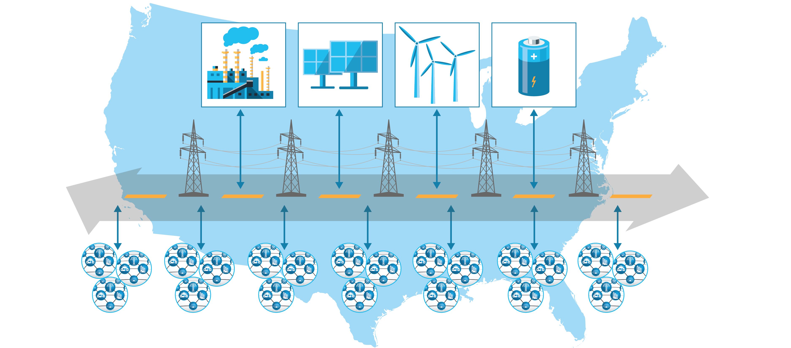
Nationwide Cheap Power Super Highway
U.S. Power Grid of the Future
Ubiquitous Sensing and Data Collection
Seamless Integration of DERs
Active Customer Engagement
Strengthened Resiliency and Security

Slide 25


Dr. Sonja Glavaski
Program Director
Advanced Research Projects Agency – Energy (ARPA-E)
U.S. Department of Energy
sonja.glavaski@hq.doe.gov
202-287-6146
www.arpa-e.energy.gov

